Slide 1
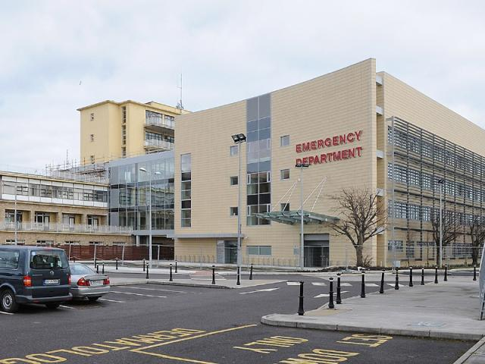
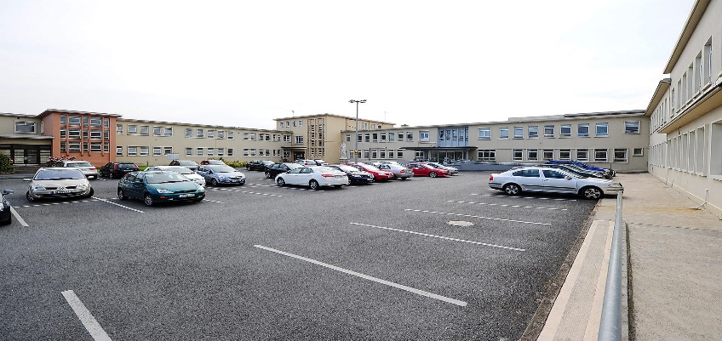
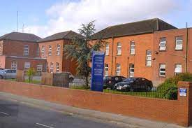
Quality Improvement Initiatives for Our Lady of Lourdes Hospital, Louth County Hospital & The Cottage Community Hub in response to the National Inpatient Experience Survey

Slide 2
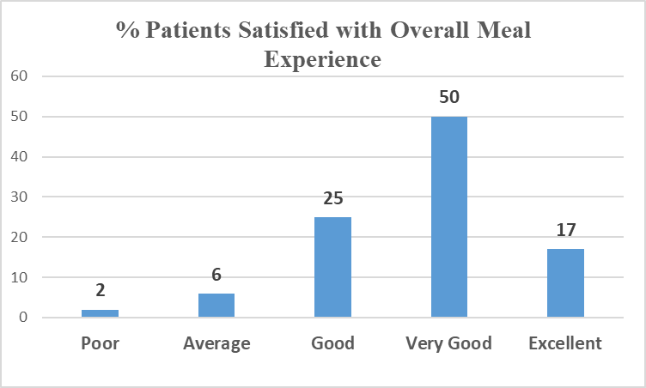
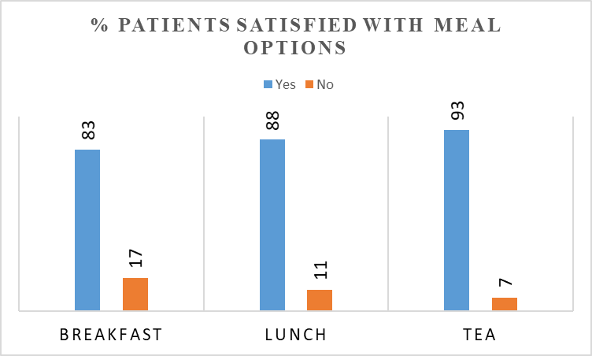
Improving Patient Satisfaction with Hospital Food & Nutrition
A Quality Improvement Initiative in Louth Hospitals
Aim: To continue to build on improvements in patient satisfaction with hospital food during their hospital stay in OLOLH 2023
Plan Review menu options to include fruit and snacks offering.
Menu & textural review with Catering, Dietetics and Speech & Language personnel input.
Education sessions to update new staff.
Complete OLOLH Patient Survey (May 2023 n=60).
Do Entire menu cycle reviewed & updated to include special diets.
Education rolled out to catering & household staff (wards) (90% attendance achieved).
Study July 2023 Results
90% of patient were offered snacks representing a significant improvement on results in 2022 (66% patients offered snacks).
94% patients on a special diet were satisfied that their dietary needs were catered for.
92% of patients rated the overall meal experience good to excellent.
Act Increase options at breakfast for patients.
Continued collaboration with Catering, Dietetics and Speech & Language.
This QI initiative is aligned to;
NIES Themes - Admission and Care on the Ward. Q15, Q16, 18 & Q19.
HIQA Safer Better Healthcare standards (2012) of Person-Centred Care & Support.
Local hospital concerns regarding patient feedback on hospital food
Next Steps
Maintain standardisation of portion sizing
Increase variety of snacks on offer

Slide 3
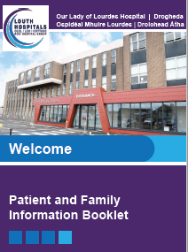
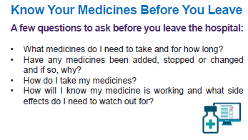
Improving communication through the provision of information
A Quality Improvement Initiative in Louth Hospitals
Aim: To improve communication with our patients during their hospital stay on all wards by December 2023
Patient Information Leaflet Strategy Louth Hospitals Patient Information Leaflet (PIL) committee was established in June 2022, the purpose of the committee is to:
To approve standardised hospital branding for use on patient information leaflets from Louth Hospitals
Clinical content included in PIL to be approved via Clinical Governance
Procurement process has been initiated & approved
Plan Developed a patient information booklet with key information about the hospital to be given to all in-patients on admission
Launch date February 2023
Individualised Patient Information Leaflets (PILs) to be standardised and disseminated relative to their individual needs
All departments encouraged to submit booklets and leaflets for acceptance by the committee
Do Continue with the PIL Committee to maintain the standardisation of all patient leaflets being printed by Staff
Study Patient survey following discharge to measure:
Did all patients receive a patient information booklet on admission?
Did the patients find the information within the booklet a) relevant & b) useful
Survey to be completed in September ( 6 months post implementation)
This QI initiative is aligned to:
NIES Theme-Admission and Care on the Ward & Discharge. Q43, Q44, Q45 & Q46
HIQA Safer Better Healthcare standards (2012) of Person-Centred Care & Support
Local hospital concerns regarding communicating with patients & relatives about their stay in hospital and their care going home.
Next Steps
Promote function of PIL Committee
Promote use of standardised. information leaflets on all wards to ensure frontline staff know about the requirement to standardise booklets and leaflets.
Understand the importance of using these leaflets as a communication tool with patients and families.

Slide 4
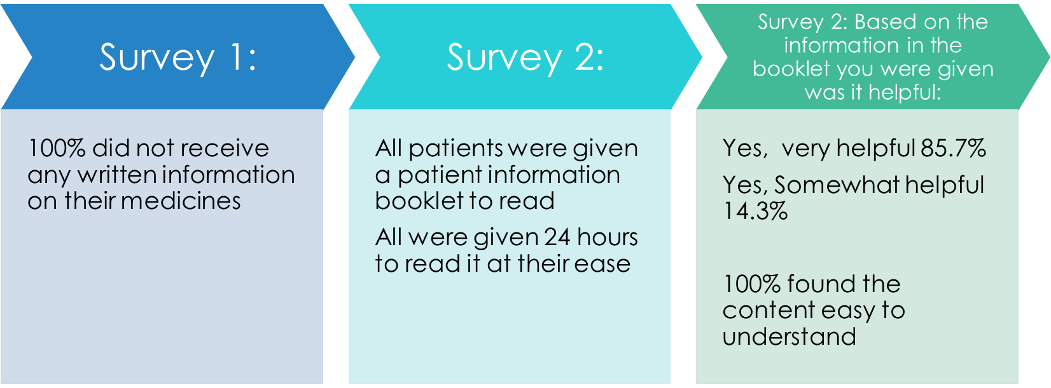
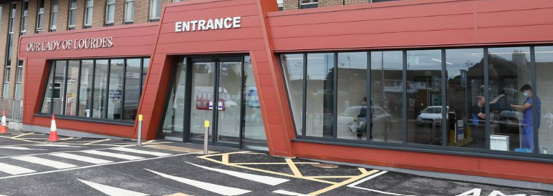
Improving patient understanding of opioid post operative pain relief
A Quality Improvement Initiative in Louth Hospitals
Aim: To improve our patients’ understanding of their opioid post-operative pain relief
Background:
Pharmacy & the Acute Pain Management team developed an Opioid Post-Operative Pain Relief Patient Information Booklet in 2022
Reviewed and approved by local D&T
Patient Survey completed on Orthopaedic ward pre and post the leaflet incorporating relevant NIES questions
Plan:
Booklet to be printed on new hospital branded booklet template
Do:
Launch of booklet on all post-operative areas where patients are prescribed opioids post-operatively
Study:
Survey staff information content in booklet to measure their opinion on its benefits
Survey patients about the usefulness of the booklet as an information tool incorporating the relevant questions from NIES
Act:
Compare with 2022 survey results
Review booklet content following patient and staff survey results
Going forward we will focus on the challenges associated with adult literacy.
Survey results:
This QI initiative is aligned to:
NIES Theme Care on the Ward, Examination, diagnosis & treatment and Discharge. Q32, Q34, Q43, Q44, Q45
HIQA Safer Better Healthcare standards (2012) of Person-Centred Care & Support
Local hospital concerns regarding the provision of information to our patients
Louth Hospitals Opioid Post-Operative Pain Relief Patient Information Leaflet
Prior to discharge your doctor will devise a pain management plan for you. Your treatment may include the prescribing of pain relieving medications including opioid pain relief and other medicines.
Next Steps
In keeping with the 2023 World Patient Safety Day theme of elevating the voice of the patient, we will focus on the challenges associated with adult literacy. Ensuring access to information for all our patients.

Slide 5
Improving Patient Satisfaction with Hospital Food & Nutrition:
A Quality Improvement Initiative in Drogheda/Louth Hospitals (2021)
Aim: To build on improvements in patient satisfaction with hospital food during their hospital stay in OLOLH Q3 2022
Plan:
Identify opportunities for improvement in diet & catering.
Complete OLOLH Patient Survey-June 2022 n=60
Do:
The entire menu cycle was reviewed & updated.
Education rolled out to catering & household staff (wards) (90% attendance achieved)
Study:
Results – 34% of patient were not offered snacks
Many felt snacks were available on request rather than being offered.
73% patients were offered choice at breakfast
Act:
Snack menu to be displayed in the wards.
Increase options at breakfast.
PDSA Cycle 2:
Review breakfast options to include fruit offering.
Menu & textural review with Catering/Dietetics /SLT input
Education sessions to update new staff
This QI initiative is aligned to:
NIES Themes - Admission and Care on the Ward. Q15, Q16, 18 & Q19. HIQA Safer Better Healthcare standards (2012) of Person-Centred Care & Support. Local hospital concerns regarding patient feedback on hospital food
Next Steps
Include Q18 (Were you offered a replacement meal at another time?) in future local surveys. Catering for Hospital Staff : Happy Heart Healthy Eating Award, July 2022 Healthier options across all menus Increase oven baked vs deep fry Reduce overall fat content in menu Daily offering of fish Chip free days

Slide 6
Improving communication with our in-patients using Take 5:
A Quality Improvement Initiative in Drogheda/Louth Hospitals (2021)
Background: 2021 - increase in complaints about communication to patients & their families
Aim: To improve communication with our patients during their hospital stay on all wards by December 2022
Plan:
To phone (if applicable) patient’s family within 24 hours of admission
Introduce “Take 5” initiative
All ward/ ED nursing managers informed of new communication initiative
Phone call & Take 5 to be recorded in specific sections in Nursing notes
Do:
Implemented in July 2022 on one medical and one surgical ward
Study:
90% of patients relatives on each ward received a phone call from the ward manager within 48 hours of admission.
‘Take 5’ initiative requires further engagement with staff.
Data audited – 24 hour period of admissions randomly selected & nursing notes of same audited (paediatrics excluded)
Act:
As a result of feedback whilst auditing on wards, going forward:
Focus on two wards
Education on specifics of documentation.
Increase communication to/from ward managers.
Take 5
Hello my Name is… How are you today?
Have you any questions about what’s happening with your care?
Have you been in touch with your family today?
What did you eat & drink today?
Is there anything I can do to make your hospital stay better?
This QI initiative is aligned to:
NIES Theme - Admission & Care on the Ward 23 questions within the NIES relate to communication HIQA Safer Better Healthcare standards (2012) of Person-Centred Care & Support Local hospital – increase in complaints re access
Next Steps
Plan: Continue ‘take 5’ initiative Pilot on two wards – 1 x surgical, 1 x medical Embed phone communication Scale up phonecall & Take 5

Slide 7
Improving communications with in-patients using an information booklet:
A Quality Improvement Initiative in Drogheda & Louth Hospitals (2021)
Aim: To improve communication with our patients during their hospital stay on all wards by December 2022
New Patient Information Leaflet Strategy : Louth Hospitals Patient Information Leaflet (PIL) Committee: Established June 2022
Aim to approve & procure standardised hospital branding & hard copy output from Louth Hospitals.
Clinical content to be approved via Clinical Governance.
Procurement process has been initiated & approved.
Plan:
Development of a patient information booklet with key information about the hospital to be given to all in-patients on admission.
Individualised Patient Information Leaflets (PILs) will be disseminated specific to their individual needs & will be stored in the booklet.
Estimated launch date October 2022.
Content of the booklet amended to include pharmacy advice about medication (Q44, 45 & 46).
Patient survey following discharge to measure:
Did all patients receive a patient information booklet on admission?
Did the patients find the information within the booklet a) relevant & b) useful.
Do:
Roadshow sessions on wards to raise awareness of the importance of providing all in patients with the booklet.
This QI initiative is aligned to:
NIES Theme-Admission and Care on the Ward & Discharge. Q43, Q44, Q45 & Q46 HIQA Safer Better Healthcare standards (2012) of Person-Centred Care & Support Local hospital concerns regarding communicating with patients & relatives about their stay in hospital and their care going home.
Next Steps
Promote use of the booklet on all wards to ensure frontline staff know about the booklet and understand the importance of using the booklet as a communication tool with patients and families. Launch October 2022

Slide 8
3 Quality Improvement Initiatives identified in Drogheda/Louth hospitals
In Response to the NIES (2022)
Quality Improvement Initiative #1. NIES Q32, 34, 35, 44 & 45
Aim: to educate patients utilising a post-operative analgesia leaflet throughout the surgical wards.
Background:
“Audit of 7 classes of medication used in the current post-operative analgesia pathway”
Pharmacy & the Acute Pain Management team audited the post-operative analgesia & opioid pathway on the Orthopaedic ward.
The QIP arising from this audit includes the development & introduction of a patient information leaflet providing guidance on the safe use & side effects of opioids.
Proposal: Pilot PIL on the orthopaedic ward & design a patient survey that will measure: 1. did the patient receive a leaflet? 2. did the patient find the leaflet useful/informative?
Quality Improvement Initiative #2 NIES Q46, 47, 49 & 50
Aim: to provide the patient with questions for their healthcare teams via regular visual messaging during their hospital stay.
Proposal:
Tray liner to be placed on all food trays at each mealtime.
“Before Going Home” – disposable tray liners with messaging below -
What is wrong with me?
How will it effect me?
What needs to happen for me to go home?
What date am I going home?
What do I need to know about my medications?
Quality Improvement Initiative #3 NIES Q13 & 14
Aim: to highlight the requirement that all staff introduce themselves to our patients upon interaction, both clinical & non-clinical
Q13: Did staff wear name badges?
Q14: Did the staff treating and examining you introduce themselves?
Proposal: Re-launch of “hellomynameis…”
Hospital - wide awareness campaign
Hellomynameis Day – audit staff badges on the day.
Awareness initiatives aligned to the NIES for Q3 2022
Presentation of 2022 NIES results & ‘call to action’ to HODs/CNMs/HSCPs/Catering staff World patient Safety Day 2022: QPS & Pharmacy to host display & information stand Sep 19th & 20th 2022. WHO Poster/ leaflets/ videos in obtained. #medicationwithoutharm Hellomynameis… - relaunch & roadshow information session – October 2022.

