Slide 1
Enhanced Recovery After Surgery (ERAS)
Eimear Lawlor (CMM2), Annmarie Sliney (ADOM), Ann Doherty (Cons. Anaesthetist), Doireann O’Flaherty, (Cons. Anaesthetist)
Rotunda Hospital
ERAS@rotunda.ie
Patient Information Video for Rotunda Maternity Open Week
https://rotunda.ie/eras/
https://youtu.be/mRHSScGB5_8

Slide 2
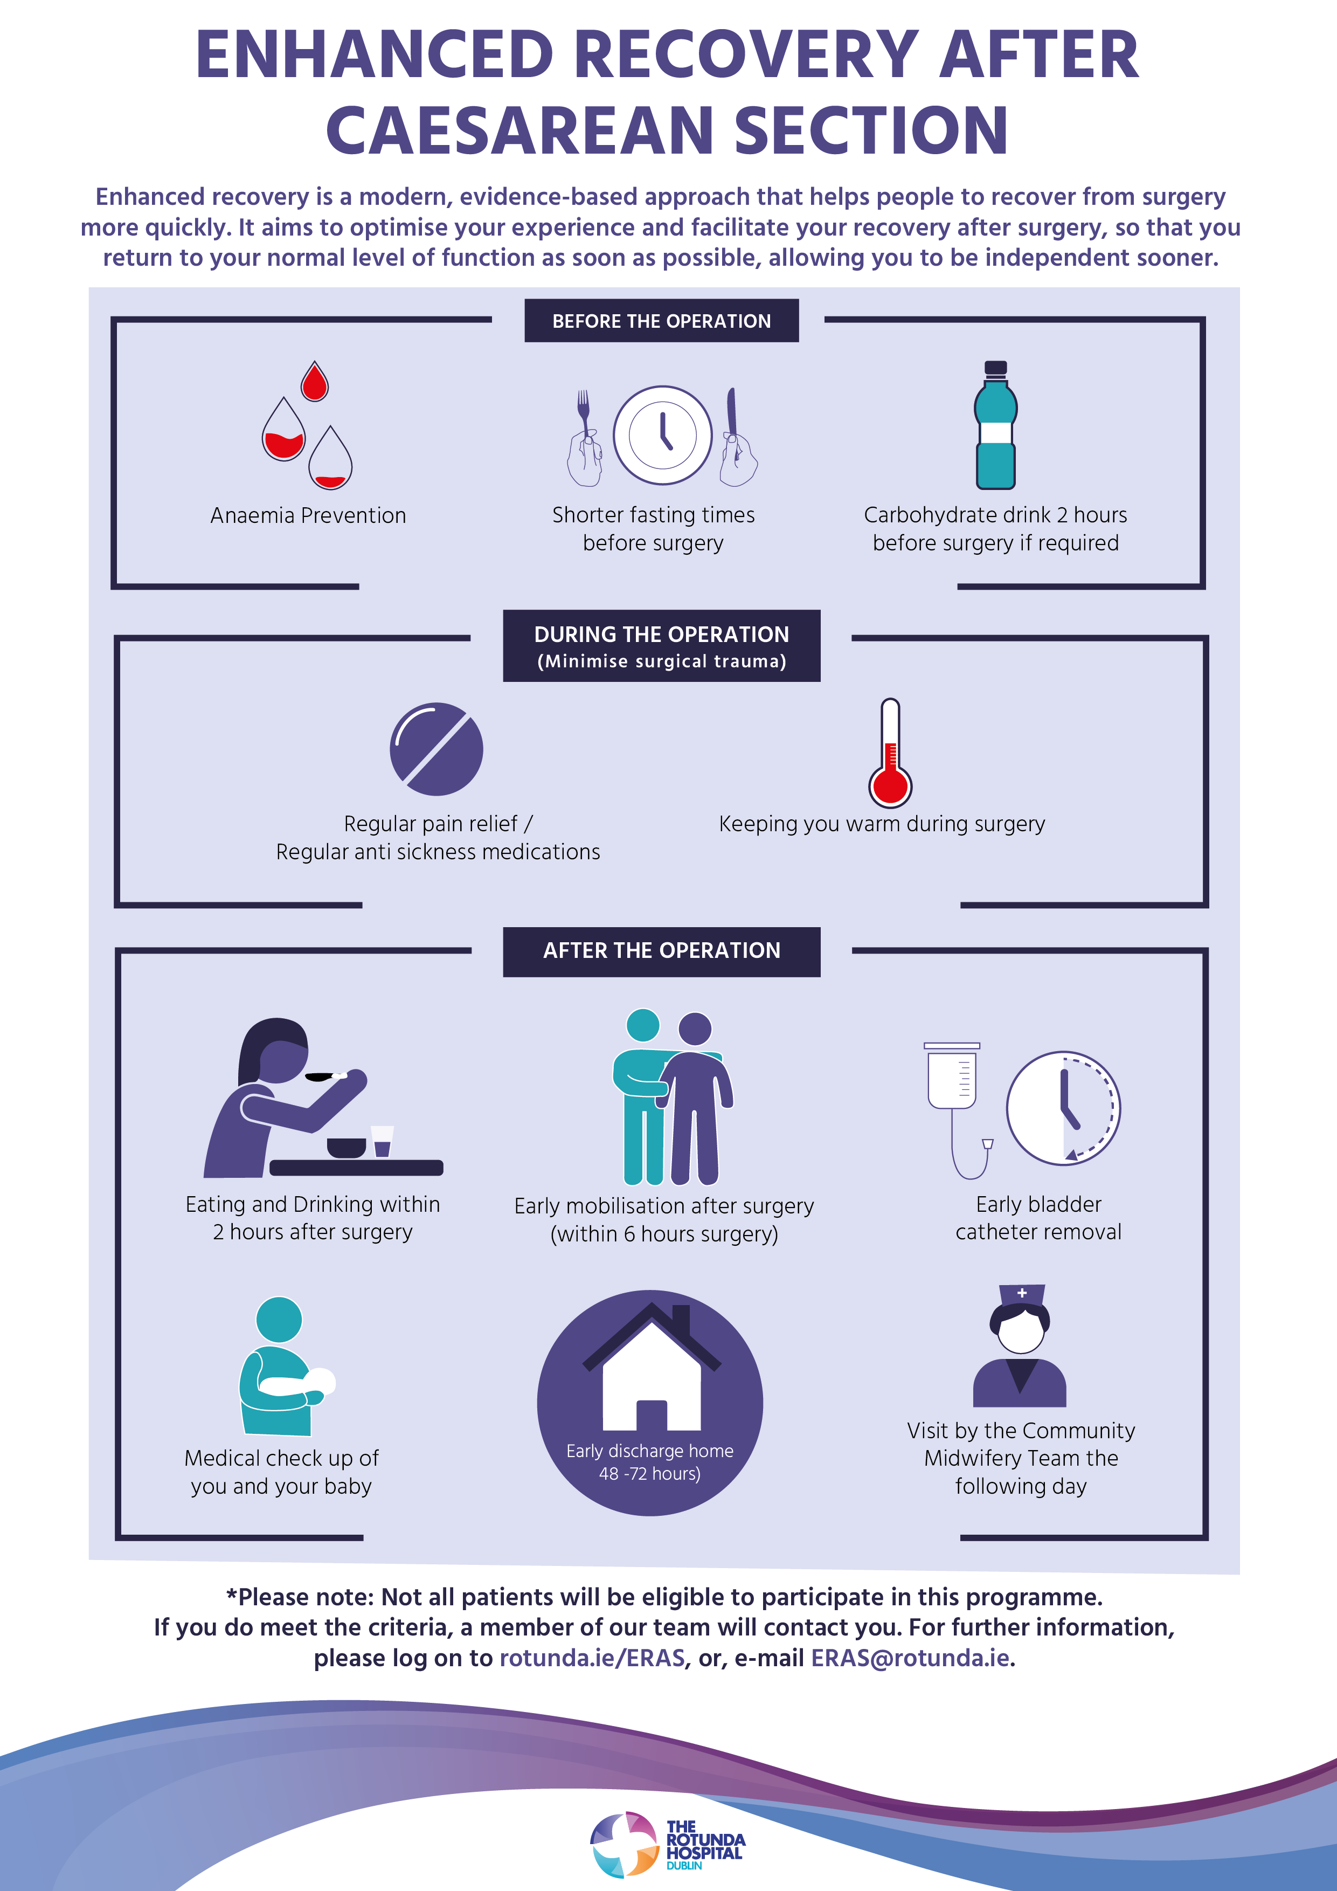
Background
Caesarean sections are the most common surgical procedure performed worldwide with rates continuing to rise. Caesarean section (CS) patients face the dual challenge of being postpartum and post-operative; therefore it is crucial we provide the highest standards of perioperative care to ensure improved recovery. Enhanced recovery after surgery (ERAS) involves a series of evidence based, patient-centred protocols that aims to standardise the perioperative care of the patient, helping patients return to their baseline level of function as soon as possible. ERAS has been shown to address the “triple aim”; improving quality of care while reducing cost and increasing patient satisfaction.
Aim:
Our overarching objective is to develop and implement Irelands’ first ERAS programme for women undergoing an Elective Caesarean Section by December 31st 2021.
Change initiative
Protocols were put in place to:
Optimize maternal anaemia
Limit fasting times pre-operatively
Prevent hypothermia
Encourage earlier resumption of oral diet post-operatively
Manage pain, nausea and vomiting
Other KPI’s
A six hour post-op care bundle was implemented to include earlier ambulation and early removal of urinary catheters.
Patients can avail of early discharge home at 48 hours.

Slide 3
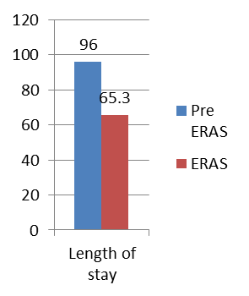
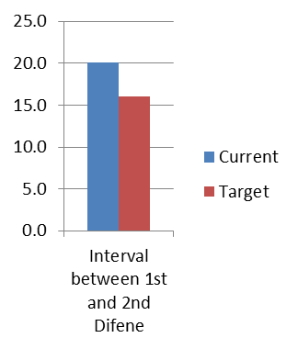
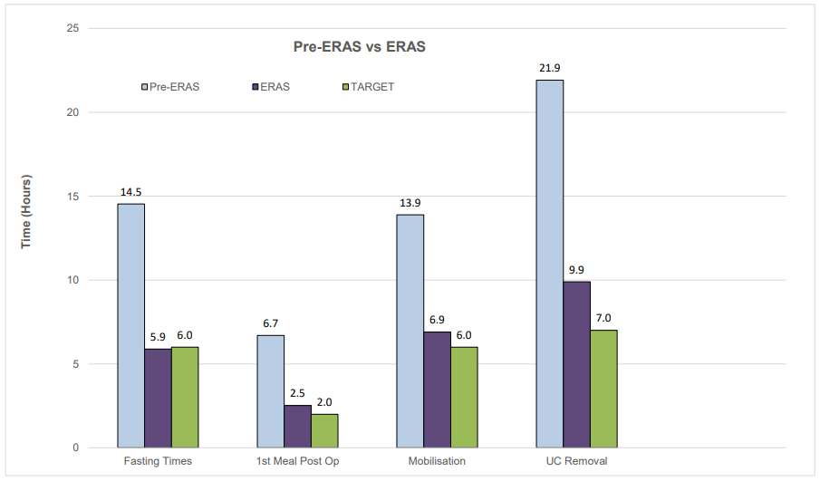
PDSA Cycles & Outcomes
PDSA 1.0: To reduce hospital Length of Stay from 5 to 2 days for mothers having a planned Caesarean Section (CS) by December 2021
PDSA 2.0: Reduce carbohydrate fasting times by providing Nutricia Pre-op drinks
PDSA 3.0: Reduce total length of time of IDC
PDSA 4.0: Expand ERAS to Postnatal ward A
PDSA 5.0: Reduce length of time between 1st and 2nd dose of PR Difene
Results:
196 patients completed the programme in 2021:
•Pre-operative fasting times reduced from an average of 14.5 hours to 5.9 hours
•Post-operative fasting times reduced from an average of 6.7 hours to 2.5 hours.
•Time of post-operative mobilisation was reduced from an average of 13.9 hours to 6.9 hours
•Time to IDC removal was reduced from an average of 21.9 hours to 9.9 hours.
•An average pain score of 1 has been reported on day one post-operatively (approx. 24 hours post- operatively). This compares to an average pain score of 1.9 pre ERAS*.
•118 women (60%) were discharged home on day two. Length of stay (LOS) for women undergoing elective cesarean section can vary between 72-120 hours (or 3-5 days). The average LOS for women who followed the ERAS pathway was 65.1 hours (or 2.7 days).
•171 women (87%) were followed up with the Community Midwifery Team (CMT) following discharge
•There were no cases of ileus
•There were no readmissions
*Data was collected on 100 patients who had undergone an EL LSCS pre-ERAS

Slide 4
Sustainment & Spread
How was the improvement sustained:
A number of factors have been instrumental in sustaining this change project to date. These include:
Having a dedicated ERAS Midwife to follow the patient and motivate staff
Identifying “champions” on each ward, robust education and staff support
Regular bidirectional staff feedback. Feedback is given to staff by means of an ERAS dashboard on the postnatal ward which includes graphs and runcharts to show progress towards targets. The dashboard functions not only to inform staff of progress but has been an important tool to motivate staff to meet targets
Feedback from the staff and the patients is encouraged and has been overwhelmingly positive
A patient satisfaction survey is sent via a text link 6 weeks postoperatively
Value to patients:
Overall, we have seen tremendous improvements in reaching some of our KPIs. The total length of stay has been reduced to an average of 65.1 hours for ERAS patients, with the majority being followed up by the Community Midwifery Team.
Spread:
The ERAS programme was expanded to a second postnatal ward in September 2021. The plan is to further expand the programme by extending the inclusion criteria to include some low risk Emergency caesarean sections and apply the pathway to major Gynaecological surgeries
Robust audit of data continues as the ERAS program progresses and improves within the hospital. This data will be used to improve the quality of care provided to women, ultimately increasing patient outcomes and satisfaction, while also empowering staff and reducing costs.

