Slide 1
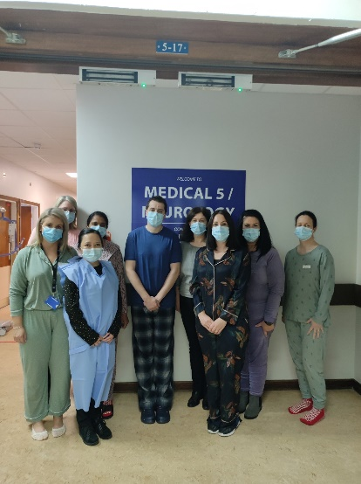
Medical 5 keeps moving to keep you improving
Vikki Sheeran
CNM2, NPDU
Sligo University Hospital
amelia.sheeran@hse.ie
Focus Group Members: Teresa Donnelly (ADON), Dean Flanagan (CNM2), Smitha Nair (CNM 1), Fidelma Martyn (ADON), Sheila Kiely (PT), Deirdre Devers (OT), Georgina Kilcoyne (Assistant GM)
Acknowledgements: All Medical 5 staff

Slide 2
68% of patients are discharged below their pre-hospital functional level and are 61 times more likely to struggle with their activities of living on discharge (ONMSD, 2021)
Medical 5 in SUH, in conjunction with the national ONMSD team, took part in the Get Up, Get Dressed, Get Moving 60 day Challenge. Evidence highlights the benefits of getting up, dressed and moving including;
reduced risk of infection, falls and pressure ulcers
reduced 30 day readmission rates
reduced risk of losing mobility and agility and of losing fitness and strength
This initiative focused on some of the most vulnerable people in our healthcare system, helping to enhance patient experience and protecting both mobility & cognitive function of our patients. Medical 5 specialises in the care of patients with neurological conditions.
What was our aim?
Our aim was to engage with health professionals to roll out the GUGDGM 60 day challenge in Medical 5 in supporting and empowering patients to participate in daily activity to maintain their physical and mental wellbeing.
To maintain patient mobility & guard against their deconditioning.
To promote independence and daily physical activity.
To embed the concept of early and ongoing movement into culture and practice.
Change initiative
Ensured senior management support. Identified a control ward. Set up a focus group. Agreed the participating ward. Action plan discussed and devised. Registered details with the national team. Downloaded the app. Shared the resources available. Attended webinars. Data collected for 60 days, Oct 4th – Dec 3rd.

Slide 3
P
D
S
A
P
Sign up to GUGDGM national challenge.
Gain senior management support.
D
Set up a focus group.
Decide control ward.
Agree participating ward.
Develop action plan.
Communicate and disseminate information.
Develop daily movement chart for use at local level.
Collect data on a daily basis.
NPDU to provide daily support.
S
Verbal feedback from Medical 5 staff, student nurses and HSCP’s.
Verbal feedback from patients on Medical 5.
Analyse data & compare incidence of falls and pressure ulcers with same time period in 2020.
A
Roll out to other wards throughout SUH.
Disseminate results from data collected.

Slide 4
Sustaining the initiative
Maintaining a focus on the initiative, with continued senior management and NPDU support.
Continuing to collect and analyse data on daily movement chart at a local level.
Disseminating results, improvements and information.
Raising awareness of the improvements and patient benefits throughout the hospital.
Sharing the learning with other areas.
Dedication and commitment from the staff involved continues to sustain the initiative.
Benefits to patients
“I always feel so much better when I put my day clothes on rather than getting into my pj’s after my shower”
(Female patient stated on Medical 5 one morning).
Reduced incidence of falls, when compared with same timeframe in 2020.
Reduced incidence of pressure ulcers, when compared with same timeframe in 2020.
Where to next?
This initiative will be rolled out to other areas in SUH.
Additional Information
Prior to the start of the GUGDGM 60 day challenge in Medical 5, a competition was set up with all staff invited to come up with a catchy title/name for the challenge. This created great energy, involvement and motivation on the ward. Davinia (S/N) came up with “Medical 5 keeps moving to keep you improving” title for the challenge and was chosen as the overall winner.

