Slide 1
Quality Improvement Initiatives across the RCSI Hospital Group in response to the National Inpatient Experience Survey 2021 & 2022

Slide 2
Introduction
The National Inpatient Experience Survey (NIES) is a nationwide survey asking patients about their recent experiences in hospital. The purpose of the survey is to learn from patients’ feedback in order to improve hospital care. The most recent survey took place in May 2022. Following on from the survey each acute hospital in the RCSI HG conducted an analysis of the feedback. Following this analysis a number of Quality Improvement (QI) projects have been developed by each hospital and these QI projects are outlined beneath.
Each hospital has used a QI approach to make changes to the way healthcare staff deliver care and services. QI projects use feedback from patients along with the knowledge and experience of healthcare staff to see where improvement is required. Changes are then made to that service. Once the change is in place healthcare staff then measure or monitor it to check whether the change has led to an improvement.
On behalf of the Royal College of Surgeons Ireland (RCSI) Hospital Group, we would like to thank all the patients who participated in the National Inpatient Experience Survey. This feedback is invaluable in helping us to understand individual experiences and to assess our service performance against patient expectations. We expect that this will lead to an improvement in the quality of healthcare services provided for all patients.

Slide 3
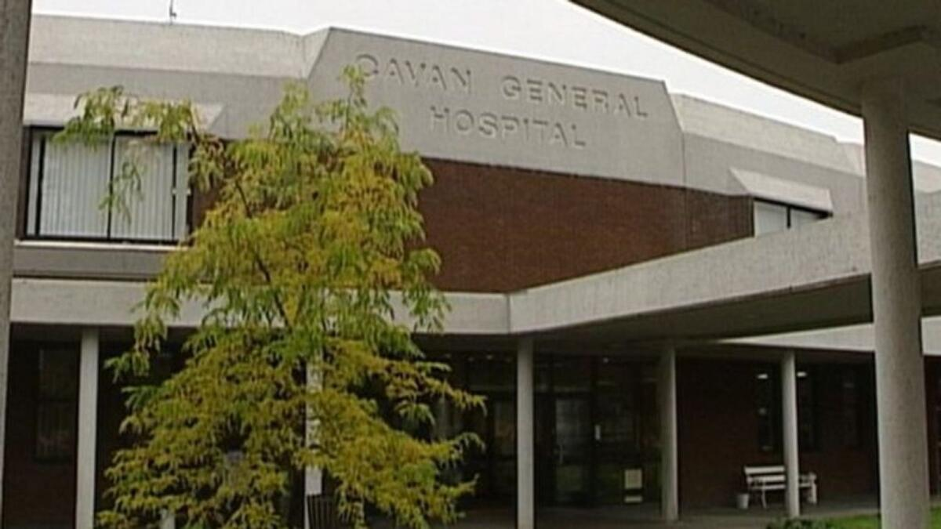
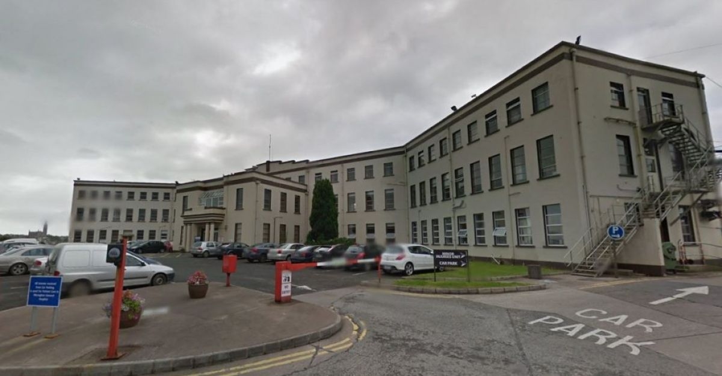
Quality Improvement Initiatives for Cavan Monaghan Hospitals in response to the National Inpatient Experience Survey 2021 & 2022

Slide 4
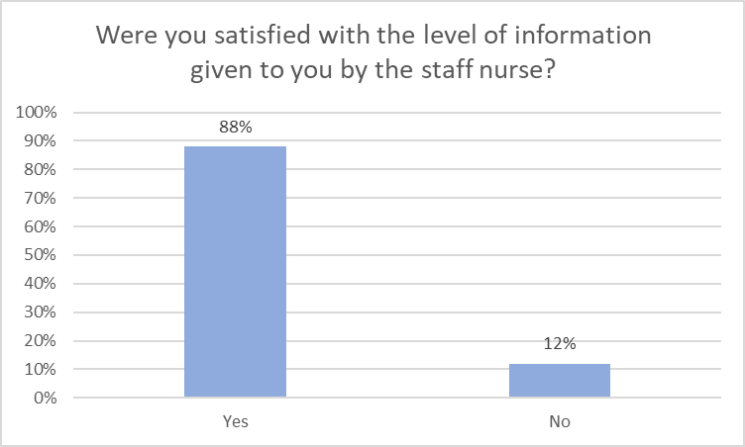
Improving communications with patients’ families
A Quality Improvement Initiative in Cavan Monaghan Hospitals (2021)
Introduction
Restricted visiting during Covid-19 resulted in an increased number of complaints from patients’ families (including formal complaints), who voiced dissatisfaction that they had not received adequate information about their family members when they were in hospital. The nursing team on a medical ward commenced an QI initiative in October 2021 to improve communications with patients’ families.
Aim: To improve communications with patients’ families during their hospital stay on a medical ward
Project Plan
MDT Brainstorming session on causes of complaints, challenges for staff communicating with families and identify change ideas.
Developed a multidisciplinary communications booklet to document communication between staff and the patient’s Designated Contact Person (DCP).
Guidance on GDPR for staff when relaying patient’s information to DCP.
Focused Communication training for ward staff.
PDSA 1. Nov 2021
Trial a MDT communications booklet to document communication between staff and the patient’s DCP.
Result
Multidisciplinary Booklet was not a sustainable long-term solution due to existing paperwork demands.
Concept of DCP established. GDPR/ethical obligations clarified.
PDSA 2. Mar 2022
Implement a daily process for MDT staff to discuss communications with DCP at staff handover, MDT Whiteboard huddle and safety pause.
Result
June 2022 Family experience survey found 88% satisfaction with the level of information received from nursing staff on the ward.
PDSA 3. August 2022
1.Each patient’s DCP will be contacted by a member of the nursing team within 24 hours of their admission.
2.The NOK will be informed of patients clinical status, plan of care and relevant information re: ward visiting, contact number, discharge plan etc.
Result
67% of patients’ DCP were communicated with within 1st 24 hours
Spread July 2022
Spread to all wards, support with education.
Audit in Aug of 4 wards showed an average uptake of 50% .
Continue to drive this initiative and re-audit in September.
This QI initiative is aligned to:
NIES Theme-Admission and Care on the Ward, HIQA Safer Better Healthcare standards (2012) of Person-Centred Care & Support, Local hospital concerns regarding communicating with relatives during periods of no/restricted visiting.
Next Steps
Re-evaluate in September and monthly until embedded Measure rate of complaints re communication for the pilot ward and across hospital once spread and embedded Complete family survey by Dec 2022 to determine if initiative is addressing needs of patients’ families Document communication interactions in the nursing notes

Slide 5
Implementing Safer Discharge in Cavan Monaghan Hospitals
A Quality Improvement Initiative (2021)
Introduction
Discharge planning is a complex process for healthcare staff and the solution is multifactorial. Data from Quality Care Metrics (QCM) historically demonstrates that the Predicted Date of Discharge (PDD) on admission is not well recorded in the patient’s healthcare record and that there is a perceived reluctance to document PDD among some members of the team. An MDT team was established to focus on this phase of the discharge planning process.
Aim: To improve the discharge planning process for patients and their families on a medical ward by identifying a Planned Discharge Date (PDD) within 24 hours of admission.
Change interventions
PDSA 1. Mar 2022
To discuss PDD for all patients and add to the white board in the Pilot Ward.
This initiative commenced in July.
Findings
Discussing and recording the PDD requires constant reinforcement.
It can be difficult to predict some patients PDD if they are clinically unstable or a complex discharge.
Result
In April a snap-shot audit showed 20% of patients had a PDD.
PDSA 2. Aug 2022
To involve MDTs in reviewing the appropriateness of the date whilst incorporating the complexity of the patient.
Result
Anecdotal evidence of raised awareness and engagement from MDT, doctors and patients regarding the PDD.
In August an average of 75% of patients had a PDD.
September snap-shot audit showed 100% of patients had a PDD.
This QI initiative is aligned to:
NIES Theme-Admission and Care on the Ward, Q40, Q41, Q43, Q47, Q48. HIQA Safer Better Healthcare standards (2012) of Person-Centred Care & Support, Local hospital-concerns re: late notification of discharge, insufficient referrals to the discharge lounge.
Next Steps
Evaluate the impact of PDD on discharge. Undertake a root cause analysis of the discharge process to help prioritise additional QI interventions.

Slide 6
3 Quality Improvement Initiatives identified in Cavan Monaghan Hospitals
In Response to the NIES (2022)
Quality Improvement Initiative #1
Background: Medication reconciliation is not currently standard practice across the hospital and for many patients, it is acknowledged that medication reconciliation is a pre-requisite to giving accurate medication information to patients.
Q44:Did a member of staff explain the purpose of the medicines you were to take at home in a way you could understand? (Score 7.3, Nat Ave. 7.9).
Q45:Did a member of staff tell you about medication side effects to watch for when you went home? This was one of our lowest ranking questions. (Score 5.2, Nat. Ave. 5.4).
Aim: To improve education provided to patients during inpatient stay and on discharge about their medications.
Proposal
To conduct medication reconciliation with all patients who meet the criteria.
Provide patients with information about their medicines.
Progress
An improvement team has been established with support from the General Manager, Chief Pharmacist and Director of Nursing.
A pilot ward has been identified.
A pharmacist and staff from Nurse Practice Development will provide education to nurses on the pilot ward and support them in becoming proficient in providing patient information.
Update patient information leaflets (including use and side effects) for the most frequently used medications.
Quality Improvement Initiative #2
Aim: To standardise the approach to communication with patients’ families across Cavan hospital.
Q48: Did the doctors or nurses give your family or someone close to you all the information they needed to help care for you? (Score 6.4, Nat Ave. 6.2).
Proposal:
Continue to spread this initiative hospital-wide.
Identify additional communication needs for patients post local survey.
Quality Improvement Initiative #3
Aim: Continue to drive and expand the Discharge Planning project.
Q43: Before you left hospital, were you given any written or printed information about what you should or should not do after leaving hospital? (Score 6.2, Nat Ave. 5.9).
Proposal
An audit of the discharge process is currently underway, the findings will guide the team on specific areas for improvement.
This is a complex initiative and will require a mix of interrelated projects prior to achieving improvements, therefore we expect a number of projects will be commenced.
.

Slide 7
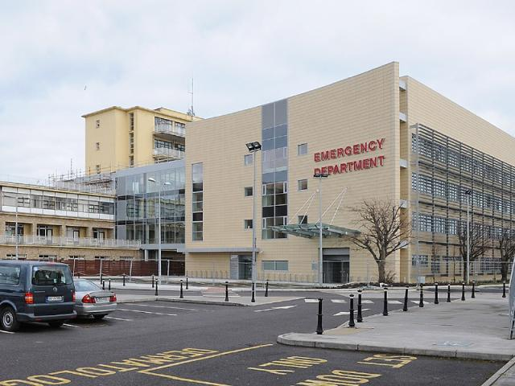
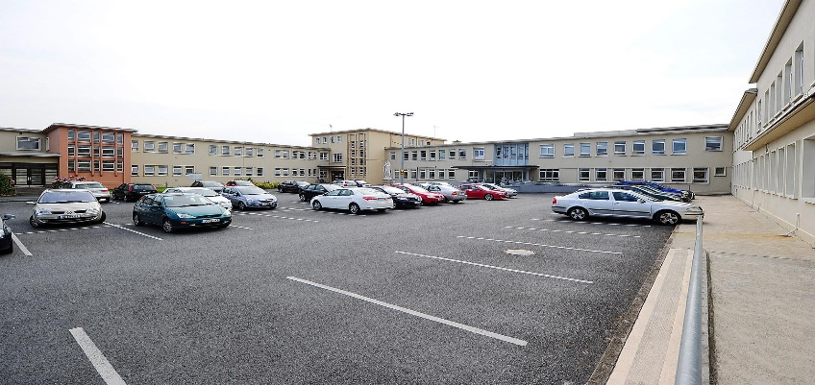
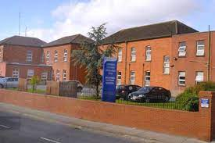
Quality Improvement Initiatives for Our Lady of Lourdes Hospital, Louth County Hospital & The Cottage Community Hub in response to the National Inpatient Experience Survey 2021 & 2022

Slide 8
Improving Patient Satisfaction with Hospital Food & Nutrition:
A Quality Improvement Initiative in Drogheda/Louth Hospitals (2021)
Aim: To build on improvements in patient satisfaction with hospital food during their hospital stay in OLOLH Q3 2022
Plan:
Identify opportunities for improvement in diet & catering.
Complete OLOLH Patient Survey-June 2022 n=60
Do:
The entire menu cycle was reviewed & updated.
Education rolled out to catering & household staff (wards) (90% attendance achieved)
Study:
Results – 34% of patient were not offered snacks
Many felt snacks were available on request rather than being offered.
73% patients were offered choice at breakfast
Act:
Snack menu to be displayed in the wards.
Increase options at breakfast.
PDSA Cycle 2:
Review breakfast options to include fruit offering.
Menu & textural review with Catering/Dietetics /SLT input
Education sessions to update new staff
This QI initiative is aligned to:
NIES Themes - Admission and Care on the Ward. Q15, Q16, 18 & Q19. HIQA Safer Better Healthcare standards (2012) of Person-Centred Care & Support. Local hospital concerns regarding patient feedback on hospital food
Next Steps
Include Q18 (Were you offered a replacement meal at another time?) in future local surveys. Catering for Hospital Staff : Happy Heart Healthy Eating Award, July 2022 Healthier options across all menus Increase oven baked vs deep fry Reduce overall fat content in menu Daily offering of fish Chip free days

Slide 9
Improving communication with our in-patients using Take 5:
A Quality Improvement Initiative in Drogheda/Louth Hospitals (2021)
Background: 2021 - increase in complaints about communication to patients & their families
Aim: To improve communication with our patients during their hospital stay on all wards by December 2022
Plan:
To phone (if applicable) patient’s family within 24 hours of admission
Introduce “Take 5” initiative
All ward/ ED nursing managers informed of new communication initiative
Phone call & Take 5 to be recorded in specific sections in Nursing notes
Do:
Implemented in July 2022 on one medical and one surgical ward
Study:
90% of patients relatives on each ward received a phone call from the ward manager within 48 hours of admission.
‘Take 5’ initiative requires further engagement with staff.
Data audited – 24 hour period of admissions randomly selected & nursing notes of same audited (paediatrics excluded)
Act:
As a result of feedback whilst auditing on wards, going forward:
Focus on two wards
Education on specifics of documentation.
Increase communication to/from ward managers.
Take 5
Hello my Name is… How are you today?
Have you any questions about what’s happening with your care?
Have you been in touch with your family today?
What did you eat & drink today?
Is there anything I can do to make your hospital stay better?
This QI initiative is aligned to:
NIES Theme - Admission & Care on the Ward 23 questions within the NIES relate to communication HIQA Safer Better Healthcare standards (2012) of Person-Centred Care & Support Local hospital – increase in complaints re access
Next Steps
Plan: Continue ‘take 5’ initiative Pilot on two wards – 1 x surgical, 1 x medical Embed phone communication Scale up phonecall & Take 5

Slide 10
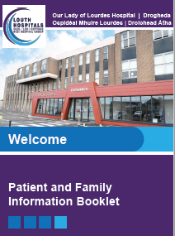
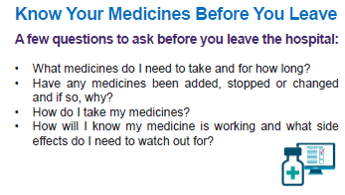
Improving communications with in-patients using an information booklet:
A Quality Improvement Initiative in Drogheda & Louth Hospitals (2021)
Aim: To improve communication with our patients during their hospital stay on all wards by December 2022
New Patient Information Leaflet Strategy : Louth Hospitals Patient Information Leaflet (PIL) Committee: Established June 2022
Aim to approve & procure standardised hospital branding & hard copy output from Louth Hospitals.
Clinical content to be approved via Clinical Governance.
Procurement process has been initiated & approved.
Plan:
Development of a patient information booklet with key information about the hospital to be given to all in-patients on admission.
Individualised Patient Information Leaflets (PILs) will be disseminated specific to their individual needs & will be stored in the booklet.
Estimated launch date October 2022.
Content of the booklet amended to include pharmacy advice about medication (Q44, 45 & 46).
Patient survey following discharge to measure:
Did all patients receive a patient information booklet on admission?
Did the patients find the information within the booklet a) relevant & b) useful.
Do:
Roadshow sessions on wards to raise awareness of the importance of providing all in patients with the booklet.
This QI initiative is aligned to:
NIES Theme-Admission and Care on the Ward & Discharge. Q43, Q44, Q45 & Q46 HIQA Safer Better Healthcare standards (2012) of Person-Centred Care & Support Local hospital concerns regarding communicating with patients & relatives about their stay in hospital and their care going home.
Next Steps
Promote use of the booklet on all wards to ensure frontline staff know about the booklet and understand the importance of using the booklet as a communication tool with patients and families. Launch October 2022

Slide 11
3 Quality Improvement Initiatives identified in Drogheda/Louth hospitals
In Response to the NIES (2022)
Quality Improvement Initiative #1. NIES Q32, 34, 35, 44 & 45
Aim: to educate patients utilising a post-operative analgesia leaflet throughout the surgical wards.
Background:
“Audit of 7 classes of medication used in the current post-operative analgesia pathway”
Pharmacy & the Acute Pain Management team audited the post-operative analgesia & opioid pathway on the Orthopaedic ward.
The QIP arising from this audit includes the development & introduction of a patient information leaflet providing guidance on the safe use & side effects of opioids.
Proposal: Pilot PIL on the orthopaedic ward & design a patient survey that will measure: 1. did the patient receive a leaflet? 2. did the patient find the leaflet useful/informative?
Quality Improvement Initiative #2 NIES Q46, 47, 49 & 50
Aim: to provide the patient with questions for their healthcare teams via regular visual messaging during their hospital stay.
Proposal:
Tray liner to be placed on all food trays at each mealtime.
“Before Going Home” – disposable tray liners with messaging below -
What is wrong with me?
How will it effect me?
What needs to happen for me to go home?
What date am I going home?
What do I need to know about my medications?
Quality Improvement Initiative #3 NIES Q13 & 14
Aim: to highlight the requirement that all staff introduce themselves to our patients upon interaction, both clinical & non-clinical
Q13: Did staff wear name badges?
Q14: Did the staff treating and examining you introduce themselves?
Proposal: Re-launch of “hellomynameis…”
Hospital - wide awareness campaign
Hellomynameis Day – audit staff badges on the day.
Awareness initiatives aligned to the NIES for Q3 2022
Presentation of 2022 NIES results & ‘call to action’ to HODs/CNMs/HSCPs/Catering staff World patient Safety Day 2022: QPS & Pharmacy to host display & information stand Sep 19th & 20th 2022. WHO Poster/ leaflets/ videos in obtained. #medicationwithoutharm Hellomynameis… - relaunch & roadshow information session – October 2022.

Slide 12
Quality Improvement Initiatives for Connolly Hospital in response to the National Inpatient Experience Survey 2021 & 2022

Slide 13
Improving Communication with patient’s families
A QI Initiative on a ward in CHB (2021)
Introduction:
Feedback from the National Inpatient Experience Survey indicated there was a lack of communication between healthcare staff and patients families. Visiting restrictions during COVID-19 pandemic contributed further to challenges in this area.
Aim: To improve communication between healthcare staff and patients families.
Project Plan
CNM/Nurse-in-charge will identify patient’s family who need to be contacted on admission.
PDSA 1. April 2022
Patients next-of-kin (NOK) were contacted by a member of nursing staff within 24 hours of their admission.
The NOK was informed of patients clinical status, plan of care and relevant information re ward visiting, contact number etc.
PDSA 2. May 2022
In addition to admitted patients, patient families were also contacted during or prior to internal or external transferring of patients.
Result
Reduction in the overall communication complaints by 25% from end of April 2022 since project was first tested.
A mean of 73.5% of families contacted between April and July 2022
This QI initiative is aligned to:
NIES feedback to Q27 & Q48. HIQA Safer Better Healthcare standards (2012) of Person-Centred Care & Support. Local hospital concerns regarding communicating with relatives during periods of no/restricted visiting.
PDSA 1
Next Steps
Learning will be shared with nursing, NCHDs and HSCP. To discuss the result of the Clinical Audit with all stakeholders and agree on actions to be included in the 2022 Communication Log Project as modifications or points for improvements.

Slide 14
Provision of Discharge Summaries
A QI Initiative on a ward in CHB (2021)
Introduction:
NIES feedback identified opportunities for improving the provision of information detailing treatments provided to patients during their in-patient stay.
Aim: To improve the number and quality of discharge summaries provided to patients GP’s within 1 week of discharge.
Project Plan
An electronic system for completing Discharge Summaries was introduced (iPMS)
Focus on increasing the number of discharge summaries through weekly team feedback.
Upgrading software infrastructure and procuring additional 3 workstation on wheels (computer hardware) for discharge summaries.
Monthly Audit on Discharge Summaries by Business Manager
PDSA 1. May 2022
A prompt was added to template to ensure medication fields are completed.
PDSA 2. June 2022
The Medical Records Manager has put processes in place to access medical records to complete summaries for patients post discharge.
Result
Increase in number of completed discharge summaries overtime by 42%
Improvement in the overall quality standards on discharge summaries- July 2022 with an average rating of 92%.
This QI initiative is aligned to:
NIES theme Discharge and Transfer, Q43, Q46, Q49, Q50. HIQA National Standards for Clinical Summary Local hospital concerns regarding the number of outstanding discharge summaries and complaints about the lack of same.
Next Steps
Ongoing monitoring of compliance with the target KPI Continued Support and education for clinical staff Long term plan for integration of iPMS with Healthlink to allow electronic sharing of discharge summaries with referring GPs.

Slide 15
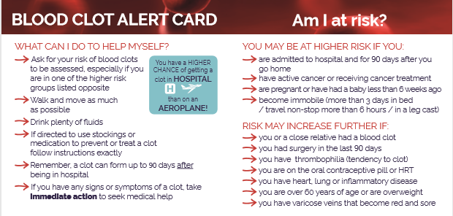
Provision of information to patients regarding VTE prophylaxis
(Blood clotting) medication. A QI Initiative in CHB (2021).
Introduction:
NIES feedback indicated that patients were not given sufficient information regarding medications on discharge. This project involved issuing educational leaflets to patients going home on VTE prophylaxis medication.
Aim: To empower patients to seek medical advice for any side effects related to VTE prophylaxis medications and to educate patients about the benefits and risks of VTE prophylaxis medication and increase compliance of same.
Change interventions
Project Plan
Focus on the provision of information cards to patients who are on VTE prophylaxis medication
To educate frontline staff who are responsible in providing the information card on top of usual care of giving verbal information to these patients.
PDSA 1. May 2022
This project was piloted in one ward with a planned audit for September ‘22
This QI initiative is aligned to:
NIES Feedback to Q25, Q28 & Q35. HIQA Safer and Better Healthcare standards (Person-Centred Care) Local hospital to increase provision of information to patients about high risk medications such as VTE prophylaxis
Next Steps
Await appointment of new Medication Safety Pharmacist to lead and drive this project Long term plan to spread across the hospital pending assessment of impact Long term plan of educating frontline staff about ‘Know, Check, Ask Campaign to promote medication safety and avoid preventable harm.

Slide 16
3 Quality Improvement Initiatives for NIES (2022) in CHB
Quality Improvement Initiative #1
Improving Choice in Hospital Food, CHB.
Team: Dietetics, Catering, Clinical Service & QPS. NIPES Q15, Q16 & Q18
Aim To develop and implement a menu for regular diet to be rolled out to all wards. Improve quality in vegetarian options on the menu. To provide patients with written information on food and hydration on admission to hospital.
Planning Design and implement a regular hospital menu. Review and improve vegetarian options currently available. Design a satisfaction survey questionnaire for the vegetarian cohort of patients
Measurement Number of eligible patients provided with regular menu which includes a vegetarian selection. Rate of Satisfaction regarding the vegetarian food selection.
Next Steps Finalising and printing a new hospital menu PDSA will begin on September 2022.
Quality Improvement Initiative #2
Improving provision of information to patients on discharge. Team Operational Team, HSCP, Nursing, Medical / Surgical Staff. NIPES Q41, Q42, Q43, Q49, Q50
Aim Patients will be given information about important aspect of care to support full recovery at home. Focus will also continue on provision of high quality discharge summaries to patients GP’s within 1 week of discharge.
Planning Long term goal of integrating IPIMS discharge summaries with Healthlink to allow for electronic sharing of discharge summaries with patient GP’s.
Measurement 100% compliance on the provision of discharge information leaflet to patients at the time of admission in the ward. 100% compliance in the provision of discharge summary in real-time including compliance in the quality of discharge summary KPIs.
Next Steps Development of a new version discharge planning leaflet.
Quality Improvement Initiative #3
Improving communication with patients’ families through introduction of an individual communication log. NIPES Q48
Improve communication process with patients’ next-of-kin in response to the lack of communication between the MDT and patients families.
Aim To promote a holistic patient care approach involving their family member(s) while in hospital.
Planning Creation of a Communication Log as tool to become part of the nursing notes.
Measurement Improved results in NIPES 2023 re: communication with families. Reduction in the number of complaints concerning the lack of communication between health care staff and patients families.
Next Steps Regular education/reminders among involved healthcare staff at every opportunity.
Awareness initiatives aligned to the NIES for Q3 2022
World patient Safety Day 2022: QPS will display & information stand Sept 2022

Slide 17
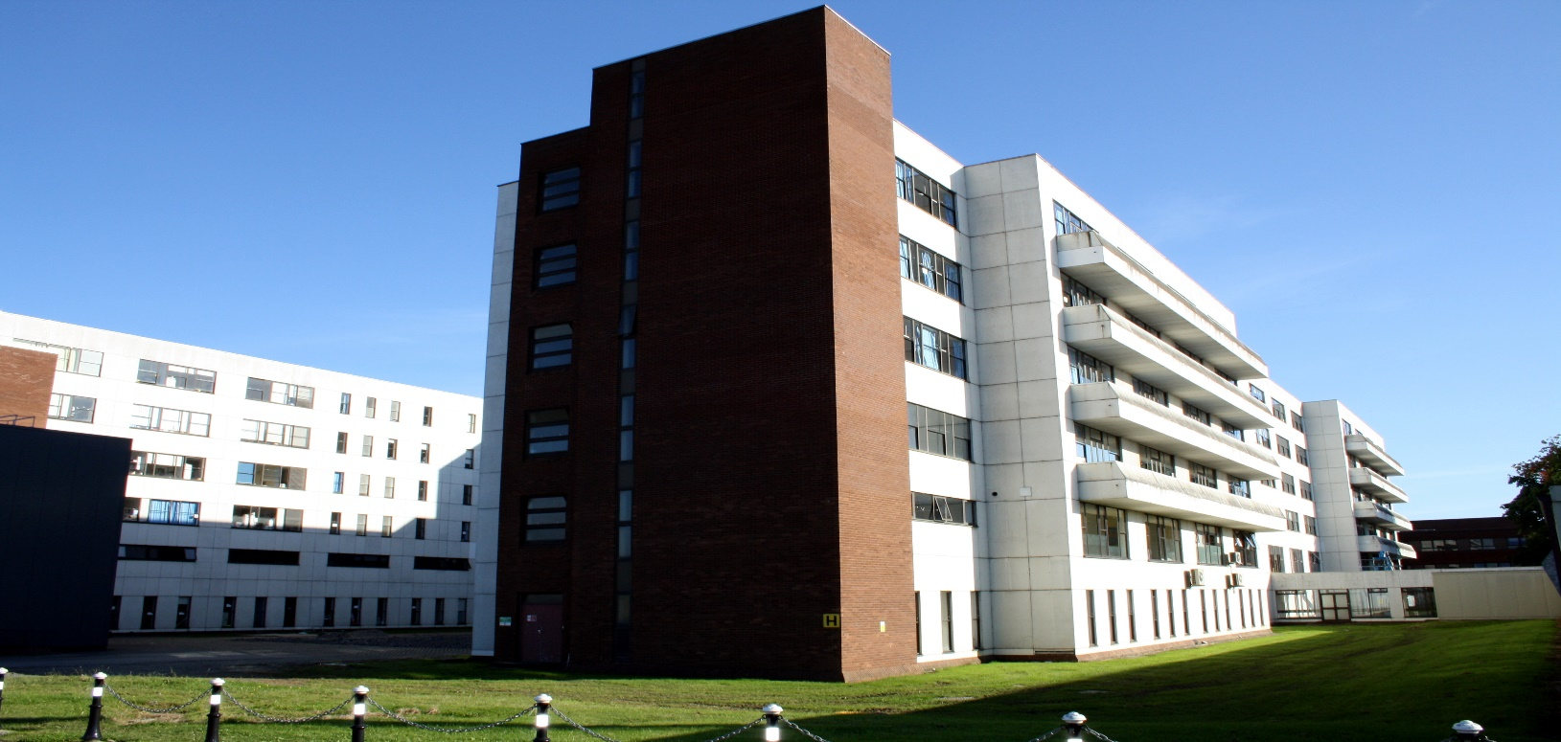
Quality Improvement Initiatives for Beaumont Hospital in response to the National Inpatient Experience Survey 2021 & 2022

Slide 18
Establishing a Patient Experience Forum in Beaumont Hospital (2021)
Introduction:
A Patient Experience Forum has been established to support the delivery of the best possible patient experience through collaboration with our patients. The forum allows for issues identified for improvement to be discussed and actions agreed to achieve improvement.
Patient Experience Forum was established with Terms of Reference including membership. The forum is chaired by the CEO and meet quarterly.
Progress
Meeting June 1st 2022
Review of updated discharge leaflet and feedback received from patients.
Raised for discussion - Beaumont Hospital Patient Charter.
Feedback from patient representatives on discharge leaflet included:
Conduct a more focused survey of patients who had been discharged with key questions about discharge.
Analyse the results and allow the findings to inform the discharge leaflet.
Outcome
A focused survey completed.
Discharge Leaflet updated as per feedback.
A proposed Patient Charter has been drafted.
Meeting August 29th 2022
Members of the Forum provided feedback on the draft Patient Charter following a period of review.
Members of the forum to review the admission patient information leaflet.
This project is aligned to:
National Inpatient Experience Survey Q24 Were you involved as much as you wanted to be in decisions about your care and treatment? HIQA Safer Better Healthcare standards (2012) Person-Centred Care & Support

Slide 19
Establishing a Patient Engagement in Beaumont Hospital (2021)
Introduction:
A Patient Engagement Committee has been established to support the delivery of the best possible patient experience through collaboration with our patients.
A Patient Engagement Committee was established in April 2022. The committee is chaired by Director of Quality & Patient Safety and links with the Patient Experience Forum. NIES Q24
The purpose of the committee is to:
Review and analyse trends emerging from patient feedback on their experience of care focusing on themes and service areas including the findings of national and local patient experience surveys ensuring that appropriate action plans are developed and implemented to deliver effective outcomes.
Review and identify issues/themes resulting from PALS complaints
Review and take into account any national guidance, initiatives and reports relating to patient experience and propose action in response.
Make recommendations to the Risk Management Committee about areas of concern and highlight areas of good practice.
Progress
Following on from work progressed under Patient Experience Forum i.e. reviewed suggested changes to discharge leaflet.
Consulted with key staff, made final changes to the discharge leaflet.
Tested with patients on a medical and surgical ward where all appropriate patients were asked to read the leaflet and make any final suggestions.
100% of patients on the wards satisfied with the leaflet.
Changes to nursing documentation to prompt the giving of discharge leaflet to patient on admission and the commencement through good communication of discharge planning.
This project is aligned to:
National Inpatient Experience Survey Q24 Were you involved as much as you wanted to be in decisions about your care and treatment? HIQA Safer Better Healthcare standards (2012) Person-Centred Care & Support.
Next Steps
Process to ensure discharge leaflet is given to patients on admission underway currently underway, Reviewing admission leaflet to ensure it is current and supports patients when being admitted to hospital.

Slide 20
Improving availability, choice and selection of food including optimising nutritional content. A QI initiative in Beaumont Hospital (2021)
Aim: To improve menu layout ensuring easy to read and understand for patients, improve specialist menus and conduct a patient focus group focusing on food and nutrition.
A Nutrition Steering Group is in place and reports into the Hospital Clinical Governance Committee.
Progress
Completed Patient survey in April 2022 with focus on current menu feedback and meal time experience.
Audits completed in Beaumont Hospital and in the Rehabilitation Unit on St Joseph’s Campus.
August 2022
Development of a new 3 week Standard Menu for the hospital.
Increased choice for vegetarian / vegan diets.
New standardised recipes developed.
Reduced repetition of menu choice.
Next steps
Tasting sessions for new menu choices.
Developing Patient Information material on menu ordering and meal time experience.
This project is aligned to:
National Inpatient Experience Survey Q15 How would you rate the hospital food? Q16 Were you offered a choice of food? Q18 Were you offered a replacement meal at another time? HIQA Safer Better Healthcare standards (2012) Person-Centred Care & Support.

Slide 21
2 Quality Improvement Initiatives for NIES (2022) in Beaumont
Quality Improvement Initiative #1
Progression of Patient Experience Forum.
Continuation of the Patient Engagement Committee.
Feedback from surveys & complaints will guide QI going forward.
NIES Q24.
Quality Improvement Initiative #1
National Inpatient Experience Survey Q24 (Score 7.5, Nat Ave. 7.8). HIQA Safer Better Healthcare standards (2012) Person-Centred Care & Support.
Quality Improvement Initiative #2
Progression of menu development and patient focus group for food and nutrition.
NIES Q15, Q16 & Q18.
Quality Improvement Initiative #2
National Inpatient Experience Survey National Inpatient Experience Survey Q15 (Score 6.4, Nat Ave. 6.6), Q16 & Q18 (Score 6.2, Nat Ave. 6.8). HIQA Safer Better Healthcare standards (2012) Person-Centred Care & Support. Better Health & Wellbeing

