Slide 1
Notes:
Thank you Helen, I will talk through a process for undertaking a QI project. My experience from working with teams here in Beaumont , mainly in OT and from my current role in the HG is that HC staff have an innate knowledge of how to go about undertaking QI , what helps though having a process or approach or method to follow as a guide. QI theory recommends that we follow a QI method that works for you and your team or one that you are familiar with and I can say that and from years of doing improvement work I can say that the more you do it in practice and use quality improvement theory as guidance the better you become at understanding what it takes to make improvement and more skilled at doing it in practice.
For this reason I have worked on simplifying an approach to QI aimed at frontline teams in undertaking quality improvement work.
In this session I will take you through the basic steps for undertaking an improvement initiative in practice. The approach I am using has come from both my experience of doing QI in practice and using QI methods to implement change..

Slide 2
What is Quality Care ?
Quality Care
Effective
Efficient
Timely
Equitable
Patient centered
Safe
Our efforts for change should focus on improving one or more of these aims of quality
Institute of Medicine 2006
Notes:
Before moving into the practice of QI ,I will briefly explain what quality and quality improvement in healthcare mean. The IOM in 2006 identified 6 aims or domains of quality. These include the provision of ….Don Berwick founder of the IHI suggests that our efforts for change should focus on improving one or more of these aims of quality. Thinking about your area for improvement look at which of these aims, and there may be more than 1 does your work sit. I have found that aligning our improvement efforts to the concept of quality is
Is helpful in engaging staff in improvement,
Reassures you that the purpose of your work is ABOUT improving quality,
Making a difference to the Q&S of patient care

Slide 3
What is Quality Improvement
Better outcomes for patients
Better experience of care
Continued development and supported staff in delivering quality care”
Definition-
Combined and unceasing efforts of everyone to make the changes that will lead to:
( Batalden and Davidoff 2007)
Notes:
It is the continuous efffort of everyone that involves looking at the practices/process and care in your area and
asking are they ‘good’
Are the safe etc
How can we make them better

Slide 4
Ref: Penny Pereira, The Health Foundation Q Managing Director

Slide 5
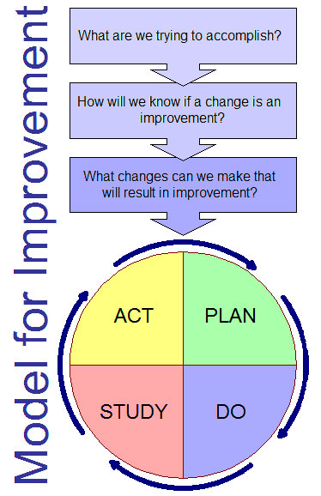
What is required for Quality Improvement
Science of Improvement
Understand the problem
Use data to analyse the problem and its causes
Build knowledge about the problem and the solution
People and change/Build will
Involve people who deliver the service-close to the problem/Get ideas
Notes:
The Science of Improvement
AS- Understand the system- look at you ward/unit /depatrmet and think about
Practices-how we do things -----------Is it the way we do the work. i.e do patients falls because we don’t risk assess them/ poor discharge- pt education or we don’t work as an MDT for complext patients
Relationships- whom do we work with alot
Who are we connected with---------- if we want to make a change will it affect work in other department i.e. we decide that all day-patients being admitted for surgery must queue and be registered on a fcfs basis regardless of the time of surgery
What are we good at
What could be better----------------This helps us to understand a problem-Not working on assumptions
Variation- what does our data tells us, does it help us to understand the problem looking to address
Knowledge- what do know and understand about the focus area / the problem-------Your building up you facts or your knowledge asn really importantly as you go through you QI initiative – continue to build
Psychology- people – human side- relationships- experience of previous improvement work- how they can be motivated, influenced- you can follow the process but you have to win-winning hearts and minds

Slide 6
Benefits of using a QI approach
Difficult
Need to plan for sustainment
Trying to change embedded practices
Measure impact
Multiple professions
Solution not clear
Don’t fully understand the problem

Slide 7
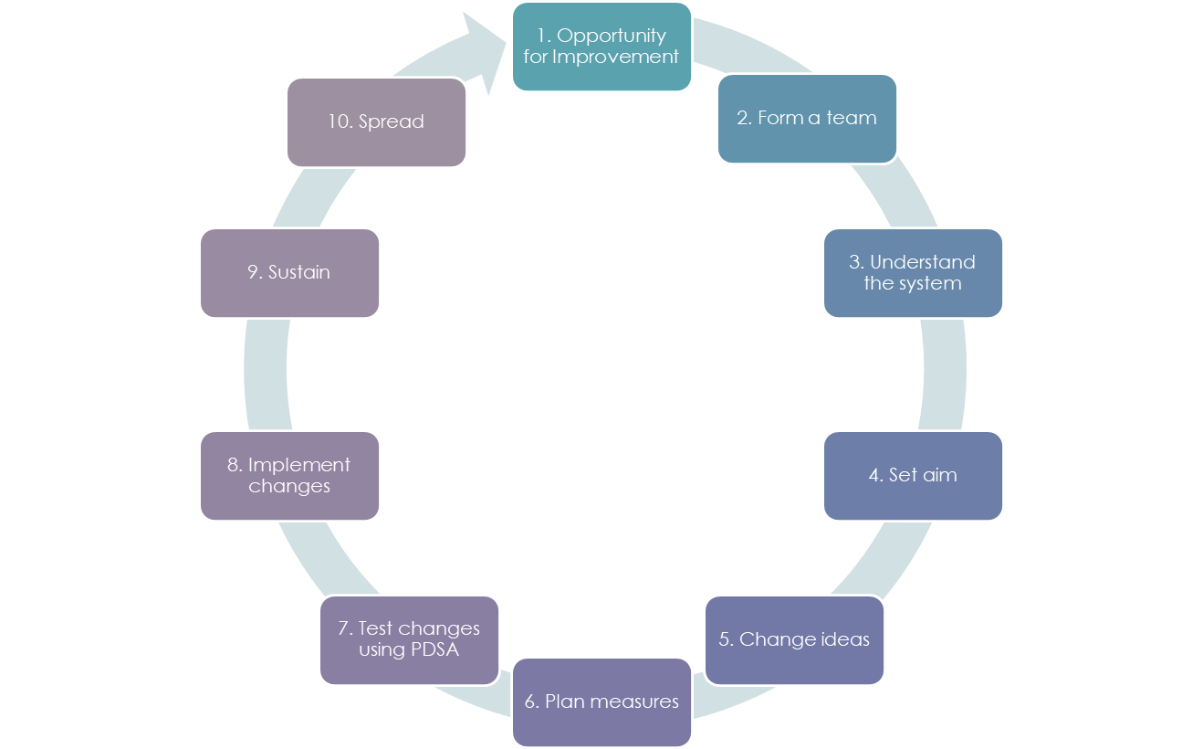
The Model for Improvement Simplified
10 steps to Quality Improvement

Slide 8
10 steps to Quality Improvement
1. Opportunity for Improvement
2. Form a team
3. Understand the system
4. Set aim
5. Change ideas
6. Plan measures
7. Test changes using PDSA
8. Implement changes
9. Sustain
10. Spread
10 steps to Quality Improvement
Notes:
Moving from the theory to the practice of QI, this cycle of steps will guide you through the process from having an idea, a need or requirement to implementing change in practice. This approach can be used irrespective of which QI methodology you use. I will describe later a scientific model ‘ The Model for Improvement’ used in healthcare for QI .
Why would you use an approach or method to implement changes?
The change you are trying to make may be difficult or challenging,
you may not know the real cause of the problem or the right solution,
or you may need to test out a number of solutions,
it may require the support of a wider team , not directly under your influence,
it may cross many departments or processes or
on the otherhand you know what needs to be implemented i.e. best practice or need to achieve a standard but you predict that introducing or embedding the change may be complicated or complex.
The benefits I have found in using a method or systematic approach is that it:
helps you plan change you are going to make,
Understand the problem in depth and the environment in which you are making the change within
get the right people involved who will support and commit to improvement
trial it in practice to see if it actually leads to improvement ,or identify issues with implementing an improved standard of care
measure the outcome of the change and if it leads to improvement
plan to implement and sustain the new way of working.
The reason I have stepped this out is because each one is important, I will describe each phase in detail but in summary Steps 1,2,3 preparing for the change, the ground work .
. 4,5,6,and 8 includes the stages in using a QI method, the MFI I have added step 7 which involves planning the implementation of changes in practice, 9 & 10 are the hard work- at this point you are planning to do something differently , you need all the relevant staff on board , this is the new way, this takes time and energy deserve to be emphasised.

Slide 9
Step 1. Opportunity for Improvement
Feedback from staff and patients- i.e. NIES
Data –KPI’s or local data
Regulatory standards i.e. HIQA
Evidence
Incident reviews
Learning from other services/networking
Learning from excellence-LFE
Notes:
Step 1 starts with identifying an opportunity or needs for improve
Data – from for i.e. local audit of quality measures, i.e. falls , pressure sores, medication errors, pain mgt etc.
Not achieving national standards
Evidence- practice and or care has evolved- need to keep up to date
Learning from improvements in other services
Once you have your opportunity for improvement, the next part of the cycle involves proactively making change.
The IHI refer to 3 key items required for improvement- Will, ideas and following a method or systematic approach.

Slide 10
Step 2. Form your QI Team
1. Who should be involved?
2. Who will influence the change
3. Who does the problem affect?
4. Include an expert
5.Include the patient voice or a patient representative/feedback
1.Identify a team leader and a sponsor
2.Confirm team members- Roles and responsibilities
3.Meetings
4.Communication
Notes:
A QI approach is used to address complex problems , complex problems tend to be difficult to solve because they can affect many parts of the system, cross-over more than one process and involve a number of and a variety of professions/ support staff which means one needs to think about who needs to be on the improvement team who will support and commit to improvements in quality.
Successful QI – requires you to win HEARTS AND MINDS., It is as much about engaging people as following a method and having the right supports around you.

Slide 11
Communication Plan
Within the ward/Department
To all disciplines
Could it be integrated into existing processes
Presenting the change and progress including measures
Allowing for all staff's views of the implementation plan
Communicating upwards

Slide 12
Step 3. Understanding the problem
What do we need to make better?
Why is it a problem? When does the problem occur?
What processes are affected
Is there data to support understanding of the problem?
The teams understanding of the problem
Use a patient story
Notes:
By now you have an identified quality problem and formed a team, the next step is to get a shared understanding of the problem, evidence suggest that many QI initiatives fail because the problem isn’t fully understood , therefore the solution wasn’t appropriate. QI theory, refer to understanding your system when making change, when thinking about the system, think about the processes, the interdependencies, context , human factors.
Some QI involves improving a standard of care because evidence has evolved and , understanding your system in this sense, guides you to think about how you will approach the change .We can use data and tools to helps understand for i.e.

Slide 13
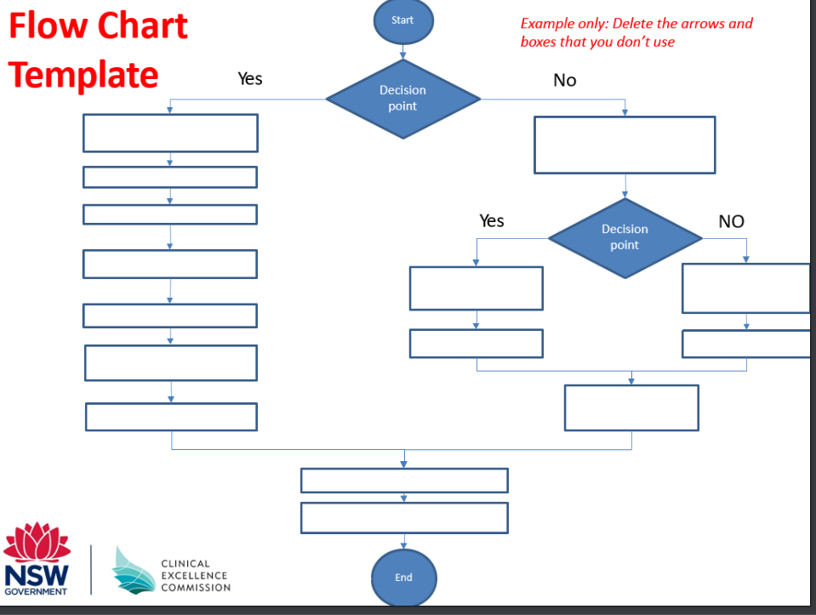
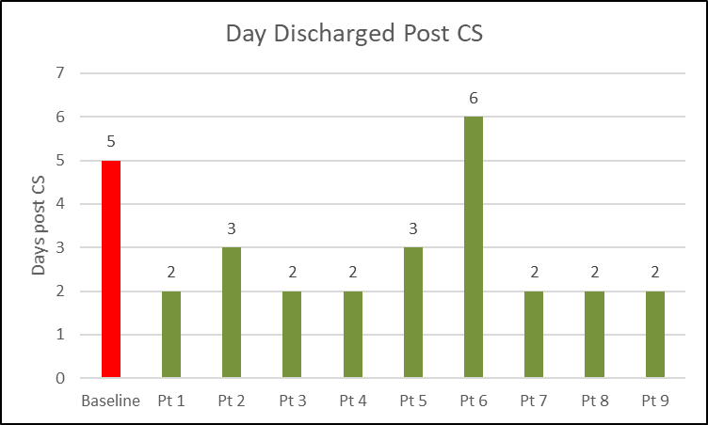
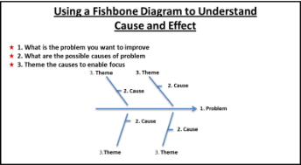
To address the problem, you need to understand the cause of the problem

Slide 14
Step 4 – set an aim & Keep it SMART
The aim is to:
Reduce the median number of falls per month on xxx ward from 5 to 3 by the end of December 2023

Slide 15
Step 5. Change ideas
Question 2 What changes will you make that will result in Improvement
Notes:
Ideas for change come from a variety of places-
For example
It is important to ensure that if there is evidence of improved practices that this should be included in the improvement or that the literature in your specific area of interest is reviewed to broaden knowledge and understanding.

Slide 16
Step 6. Measure How will you know the change has led to improvement-
Balancing Measures
Process Measures
Outcome Measures
To determine if improvement has been achieved , there needs to be measurement.
Notes:
Also focus on collecting baseline measurement to understand what performance is like at present

Slide 17
The Importance of measurement in improvement
We need to know/prove that the change has led to improvement-
Not just change for the sake of it.
Reference- Dr. Gavin Lavery , RCSI Annual conference , March 2022

Slide 18
Plan Measures
What you are going to measure
How will data be collected
Who is going to measure / Who is going to record
When are measures recorded
Where are measures recorded
How will the results be presented
Who is the audience

Slide 19
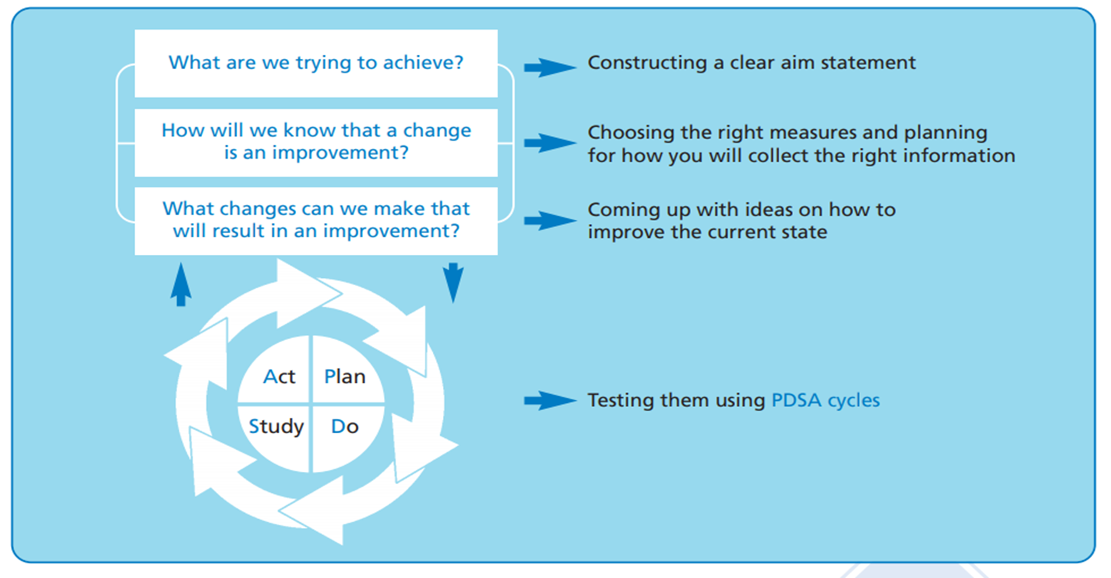
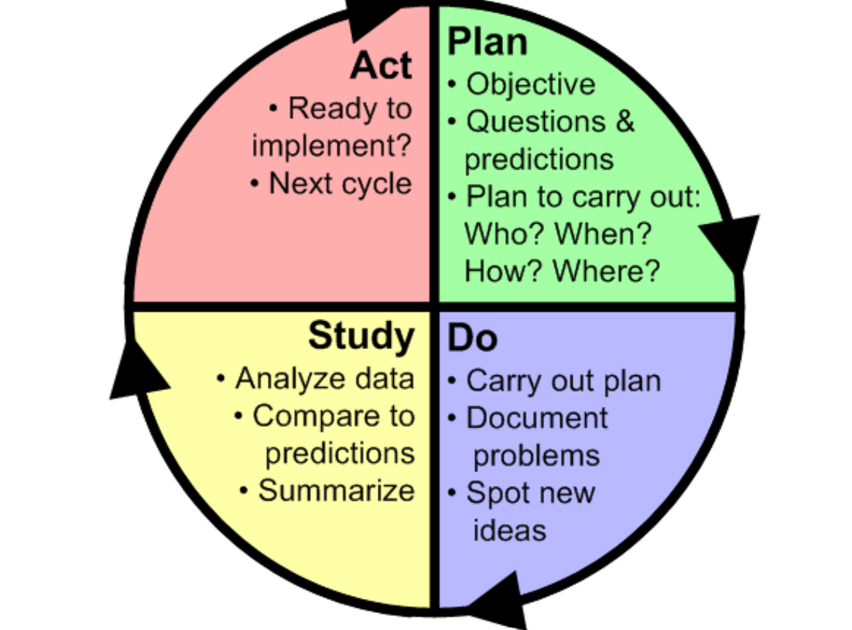
Step 7. Plan, Do, Study, Act cycle (PDSA cycle)
Notes:
PDSA is about testing, but I added a step to project plan the change
As
There can be a lot of preparation before you can test the change
i.e.
New documentation which can require a number of iterations
Education
Communication
Project planning also supports putting a time frame on an improvement project

Slide 20
Testing Change ideas in practice
Start small
Doing this while normal work continues
Want it to be safe
Reflect on the change- no assumptions
Learn
Tweek

Slide 21
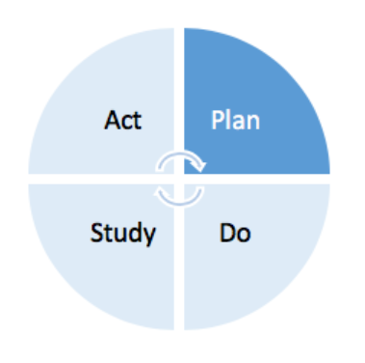
Planning phase of a PDSA
Who will do the test?
Exactly what changes will be made?
Where will the test be conducted?
When will the test be done?
What data will be collected to answer the questions in the cycle?

Slide 22
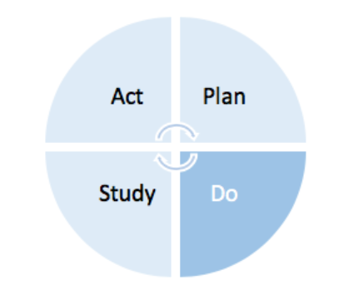
Do Phase of the PDSA cycle
Test is performed
Problems are documented
Observe for new ideas
Collect data,

Slide 23
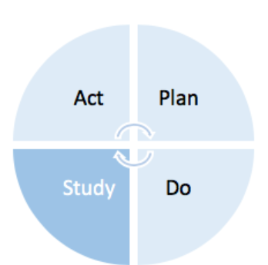
Study phase of the PDSA cycle
Asking what happened when you ran the test
Were you able to run the test
Analyse data both quantitative and qualitative data
Was there an improvement in the outcome measure when you ran the test
Was there any negative consequences with running the test
Summarise what you learnt

Slide 24
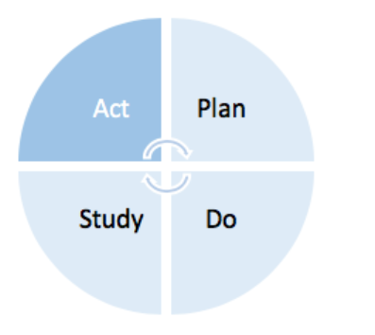
Act phase of the PDSA cycle
Does the change need to be modified slightly to get it to work better, is so adapt and run the test again on a small scale
If the change worked well, increase the scale and test again
If the change showed no improvement at all, you may decide to abandon it and test another change

Slide 25
PDSA cycles consist of:
Iterative testing
Small tests of change
Carried out in rapid cycles
Real work settings
To learn which changes in which contexts produce improvement
Several PDSA’s are linked sequentially
Tested under a variety of conditions in real work settings
Implementation of the new process cannot occur until it is highly reliable

Slide 26
Step 8. Implement
5 Steps to successful Implementation
Step 1: Standardisation
Step 2. Documentation
Step 3. Measurement
Step 4. Education
Step 5. Resources

Slide 27
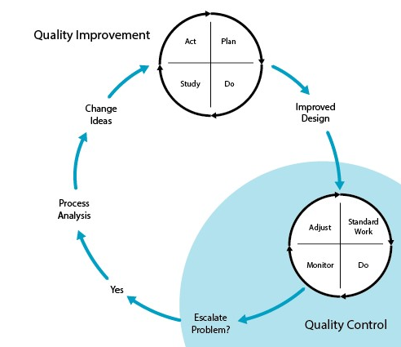
Step 9. Sustain improvement
In complex systems, processes rarely remain static, for many reasons systems are fluid.
For this reason, sustaining improvements requires:
Embed the New way
Continue to monitor
Create opportunities to escalate if problems arise
Adjust and adapt-CQI

Slide 28
Step 10. Spread Improvement
Explore opportunities to share the findings and learning,
Think flexibly,
Understand and respond to local context,
Adapt the intervention to achieve best fit with different settings. (BMJ 2019)

Slide 29
4 Essential Elements to support Quality Improvement
Leadership & Governance
Communication
Measurement
Learn

Slide 30
Stages of a QI approach
Create your Team + identify a Team Lead and build the will
Understand the problem- use data and experience
Identify a change- it may be a standard, best practice or your own ideas
Agree your aim- gives a focus, clarity on what you want to achieve , a target and a timeframe
Test the change- Small tests , quickly and study the impact, Repeat tests as required
Use measurement both outcome and process
When improvement is achieved- Implement
Sustain
Spread

Slide 31
Notes:
Qi is a skill, the more you do it the better you get and a combination of practice and learning some of the theory of QI helps to build knowledge on QI, and will therefore growing a culture for improvement.
The IHI use a phrase relating to QI, that it is ‘all teach, all learn’. I leave you with an invite to contact me if you can contribute your learning from undertaking QI work.

