Slide 1
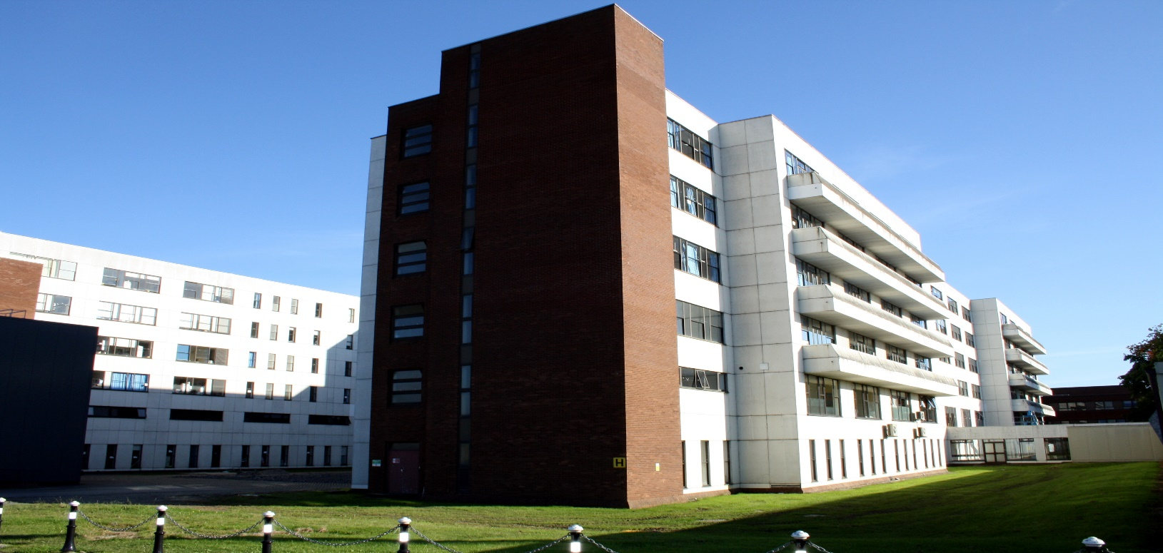
Quality Improvement Initiatives for Beaumont Hospital in response to the National Inpatient Experience Survey

Slide 2
Establishing a Patient Experience Forum in Beaumont Hospital (2021)
Introduction:
A Patient Experience Forum has been established to support the delivery of the best possible patient experience through collaboration with our patients. The forum allows for issues identified for improvement to be discussed and actions agreed to achieve improvement.
Patient Experience Forum was established with Terms of Reference including membership. The forum is chaired by the CEO and meet quarterly.
Progress
Meeting June 1st 2022
Review of updated discharge leaflet and feedback received from patients.
Raised for discussion - Beaumont Hospital Patient Charter.
Feedback from patient representatives on discharge leaflet included:
Conduct a more focused survey of patients who had been discharged with key questions about discharge.
Analyse the results and allow the findings to inform the discharge leaflet.
Outcome
A focused survey completed.
Discharge Leaflet updated as per feedback.
A proposed Patient Charter has been drafted.
Meeting August 29th 2022
Members of the Forum provided feedback on the draft Patient Charter following a period of review.
Members of the forum to review the admission patient information leaflet.
This project is aligned to:
National Inpatient Experience Survey Q24 Were you involved as much as you wanted to be in decisions about your care and treatment? HIQA Safer Better Healthcare standards (2012) Person-Centred Care & Support

Slide 3
Establishing a Patient Engagement in Beaumont Hospital (2021)
Introduction:
A Patient Engagement Committee has been established to support the delivery of the best possible patient experience through collaboration with our patients.
A Patient Engagement Committee was established in April 2022. The committee is chaired by Director of Quality & Patient Safety and links with the Patient Experience Forum. NIES Q24
The purpose of the committee is to:
Review and analyse trends emerging from patient feedback on their experience of care focusing on themes and service areas including the findings of national and local patient experience surveys ensuring that appropriate action plans are developed and implemented to deliver effective outcomes.
Review and identify issues/themes resulting from PALS complaints
Review and take into account any national guidance, initiatives and reports relating to patient experience and propose action in response.
Make recommendations to the Risk Management Committee about areas of concern and highlight areas of good practice.
Progress
Following on from work progressed under Patient Experience Forum i.e. reviewed suggested changes to discharge leaflet.
Consulted with key staff, made final changes to the discharge leaflet.
Tested with patients on a medical and surgical ward where all appropriate patients were asked to read the leaflet and make any final suggestions.
100% of patients on the wards satisfied with the leaflet.
Changes to nursing documentation to prompt the giving of discharge leaflet to patient on admission and the commencement through good communication of discharge planning.
This project is aligned to:
National Inpatient Experience Survey Q24 Were you involved as much as you wanted to be in decisions about your care and treatment? HIQA Safer Better Healthcare standards (2012) Person-Centred Care & Support.
Next Steps
Process to ensure discharge leaflet is given to patients on admission underway currently underway, Reviewing admission leaflet to ensure it is current and supports patients when being admitted to hospital.

Slide 4
Improving availability, choice and selection of food including optimising nutritional content. A QI initiative in Beaumont Hospital (2021)
Aim: To improve menu layout ensuring easy to read and understand for patients, improve specialist menus and conduct a patient focus group focusing on food and nutrition.
A Nutrition Steering Group is in place and reports into the Hospital Clinical Governance Committee.
Progress
Completed Patient survey in April 2022 with focus on current menu feedback and meal time experience.
Audits completed in Beaumont Hospital and in the Rehabilitation Unit on St Joseph’s Campus.
August 2022
Development of a new 3 week Standard Menu for the hospital.
Increased choice for vegetarian / vegan diets.
New standardised recipes developed.
Reduced repetition of menu choice.
Next steps
Tasting sessions for new menu choices.
Developing Patient Information material on menu ordering and meal time experience.
This project is aligned to:
National Inpatient Experience Survey Q15 How would you rate the hospital food? Q16 Were you offered a choice of food? Q18 Were you offered a replacement meal at another time? HIQA Safer Better Healthcare standards (2012) Person-Centred Care & Support.

Slide 5
2 Quality Improvement Initiatives for NIES (2022) in Beaumont
Quality Improvement Initiative #1
Progression of Patient Experience Forum.
Continuation of the Patient Engagement Committee.
Feedback from surveys & complaints will guide QI going forward.
NIES Q24.
Quality Improvement Initiative #1
National Inpatient Experience Survey Q24 (Score 7.5, Nat Ave. 7.8). HIQA Safer Better Healthcare standards (2012) Person-Centred Care & Support.
Quality Improvement Initiative #2
Progression of menu development and patient focus group for food and nutrition.
NIES Q15, Q16 & Q18.
Quality Improvement Initiative #2
National Inpatient Experience Survey National Inpatient Experience Survey Q15 (Score 6.4, Nat Ave. 6.6), Q16 & Q18 (Score 6.2, Nat Ave. 6.8). HIQA Safer Better Healthcare standards (2012) Person-Centred Care & Support. Better Health & Wellbeing

