Slide 2
Deming’s system of profound knowledge
System of Profound knowledge-
Profound refers to deep insight that
this knowledge offers into how to make changes that will result in improvement.
Theory or knowledge of :
Systems
Variation
Knowledge
Psychology
The four parts all interrelate
QI Leaders need to understand the basic theories behind all four

Slide 3
11 steps to Quality Improvement
1. Opportunity for Improvement
2. Form a team
3. Understand the system
4. Set aim
5. Change ideas
6. Plan measures
7. Create project plan
8. Test changes using PDSA
9. Implement changes
10. Sustain
11. Spread
11 steps to Quality Improvement
Notes:
Moving from the theory to the practice of QI, this cycle of steps will guide you through the process from having an idea, a need or requirement to implementing change in practice. This approach can be used irrespective of which QI methodology you use. I will describe later a scientific model ‘ The Model for Improvement’ used in healthcare for QI .
Why would you use an approach or method to implement changes?
The change you are trying to make may be difficult or challenging,
you may not know the real cause of the problem or the right solution,
or you may need to test out a number of solutions,
it may require the support of a wider team , not directly under your influence,
it may cross many departments or processes or
on the otherhand you know what needs to be implemented i.e. best practice or need to achieve a standard but you predict that introducing or embedding the change may be complicated or complex.
The benefits I have found in using a method or systematic approach is that it:
helps you plan change you are going to make,
Understand the problem in depth and the environment in which you are making the change within
get the right people involved who will support and commit to improvement
trial it in practice to see if it actually leads to improvement ,or identify issues with implementing an improved standard of care
measure the outcome of the change and if it leads to improvement
plan to implement and sustain the new way of working.
The reason I have stepped this out is because each one is important, I will describe each phase in detail but in summary Steps 1,2,3 preparing for the change, the ground work .
. 4,5,6,and 8 includes the stages in using a QI method, the MFI I have added step 7 which involves planning the implementation of changes in practice, 9 & 10 are the hard work- at this point you are planning to do something differently , you need all the relevant staff on board , this is the new way, this takes time and energy deserve to be emphasised.

Slide 4
Stakeholder Mapping/Analysis
Stakeholder Analysis is a way of :
identifying, prioritising and understanding your stakeholders.
TURAS Scottish Improvement HubS

Slide 5
Stakeholder Mapping/Analysis
A stakeholder analysis is an interest/influence grid with four quadrants.
It enables you to plot or map stakeholders based on their
level of interest (high/low)
level of influence (high/low).
NB. Where you plot a stakeholder guides the actions you should take for involving and communicating with them.
TURAS Scottish Improvement HubS

Slide 6
Steps to undertake your Stakeholder analysis
Step 1: Identify your stakeholders
Start by brainstorming people who may be involved or affected by your improvement project and have influence or an interest in it’s success or otherwise.
Step 2: Prioritise your stakeholders
Map your stakeholders onto the influence/interest grid, according to their level of influence and level of interest
Step 3: Understand your stakeholders
It’s essential to understand how stakeholders think and feel about your project. It will determine the best way to engage, communicate and win them over. This can be done by meeting with them and asking questions such as:
What is their opinion of the work?
What motivates them?
What interest do they have in the outcome of work? (is it positive/negative)
If they aren’t positive, what would it take for them to become so?
What information would they like and how would they like it communicated?
Step 4: Plan your communications
TURAS Scottish Improvement HubS

Slide 7
High Influence/Low Interest
High Influence /High Interest
Low Influence/Low Interest
Low Influence/
High Interest

Slide 8
Engage - high influence & low interest
These stakeholders will not want detailed communication, but because they can influence your project, enough work should be done to keep them satisfied.
An example would be a senior sponsor who receives regular progress updates.
Increasing their level of interest in the work could also be important for example if they can unlock resources or champion your work.
Involve - high interest & high influence
Stakeholders in this quadrant will be actively involved in your project and be able to exert a significant influence on how it progresses.
A lot of effort should be put in to making sure they are engaged.
An example would be teams you are working with to develop and test changes.
Keep engaged and involve where needed - high interest & low influence
Stakeholders in this quadrant will not be actively involved throughout your project but do want to hear about progress and may be able to provide input.
They need to receive regular updates, but not so much they are overwhelmed or lose interest.
An example would be teams who may be involved in the future but who are not yet actively involved who receive newsletters or social media updates.
Keep informed - low influence and low interest
These stakeholders will be part of your system and there may be the potential for your work to involve or concern them, so they should know what’s going on however do not bore them with excessive communication.
An example could be other services whose work is linked to your improvement project but has no impact on them.
TURAS Scottish Improvement Hub

Slide 9
East London Foundation Trust

Slide 10
Ref: Penny Pereira, The Health Foundation Q Managing Director

Slide 11
Influencing Stakeholders
“winning hearts and minds”
Emotionally appealing to the hearts &
logically appealing to the minds of stakeholders
to persuade them to support your improvement.
The challenge is to persuade other people to buy into your improvement initiative.

Slide 12
Appealing to the Minds of stakeholders
Tools such as graphs, process maps, Root Cause Analysis are really useful when sharing project ideas and when you need to persuade someone who is very influential to the project but has little time to discuss it.
Need a logical argument to support your perspective.
You have to prepare as you may only get one chance
Relay the benefits of your proposal/ improvement to what matters to them, is it financial savings, reduction of errors, better use of resources, fewer complaints.

Slide 13
Appealing to the Hearts of stakeholders
The majority of your focus will be on winning the hearts of your stakeholders to support your improvement work.
The art of persuading by winning hearts is about connecting people emotionally to your improvement idea and why you are doing it.
Connect with people on a very personal level.
Share patient and staff stories and experiences to demonstrate that what you’re suggesting is the right choice.
Relay the benefits of your proposal/ improvement to what matters to the stakeholders is really important.

Slide 15
Explaining Engagement of Stakeholders
Innovators and early Adopters and they make up about 20% of the group.
Need to get the 60% of the people in the middle, who are unsure about the project, to get on board.
Early Majority and Late Majority, Those in the middle who join the innovators and early adaptors ,over time, you will have 80% of people who will get on board.
The Laggards are the remaining 20% of any group. These are people who will never willingly get on board with any idea or change. We all know of people like that in our work place.
Caution
Often tend spend a lot of time trying to influence the laggard group to change or get on board, without any effect.
The people in the middle, the early and late majority, can be influenced by how much time you spend trying to influence the laggards.
If the people in the middle see that the Laggards are getting all the attention they may decide to not embrace the improvement idea.
Work will the willing. Focus your attention on winning the hearts and minds of the early and late majority.
If 80% of the group have embraced the improvement, the Laggards will reluctantly join in because they will not want to feel left out.

Slide 16
Buy-In V’s Ownership

Slide 17
Improvement Teams are beneficial in that they:
The How to Guide for Quality Improvement
The AURUM Institute

Slide 18
Form your QI Team
1. Who should be involved?
2. Who will influence the change
3. Who does the problem affect?
4. Who could prevent the changes?
5. Is there the likelihood that solution could be impacted upon by activities outside of the team
6. Is there someone at a senior level who may have greater insight into the wider system influences who should sit on the team.
7. Include an expert
8. Invite passionate and motivated people
9.Identify a team leader and a sponsor
Notes:
A QI approach is used to address complex problems , complex problems tend to be difficult to solve because they can affect many parts of the system, cross-over more than one process and involve a number of and a variety of professions/ support staff which means one needs to think about who needs to be on the improvement team who will support and commit to improvements in quality.
Successful QI – requires you to win HEARTS AND MINDS., It is as much about engaging people as following a method and having the right supports around you.

Slide 19
People who work in and contribute to the process you are trying to improve. NB Include people outside of the department/area who may be affected by the change
Nurses, Doctors, HSCP, Administrators, Support staff
People with enough knowledge to understand the implications of the change and senior enough to authorize the tests of change
Senior managers/Consultants involved in the area the change is being made
Representatives from all the staffing groups involved in the process
Someone who can represent the patient and their experiences
Senior leader who can authorize the initiative, remove obstacles, has broader system knowledge & can elevate the initiative
People enthusiastic about making improvement
Who should be on an improvement team?

Slide 20
At the start of the Project
1.Identify a team leader and a sponsor
Define the role of the team leader
Agree the commitment and reporting relationship with the sponsor
2.Confirm team members- Ensure correct membership
3. Define & Agree roles & responsibilities, i.e
Schedule meetings/Book meeting room/check attendance availability beforehand
Write up actions from each meeting
Develop Communication plan
Measurement –Data collection/ analysis/presentation
Education
Review evidence
Changes to documentation
Develop project plan
Present findings.

Slide 21
Top tips for improvement team facilitators
1.One of your biggest challenges will be to get people together.
Be sympathetic about members’ other time commitments but be firm.
Accept not everyone in the team will be able to make every meeting but try and get as many to attend as possible.
2. Encourage regular meeting times. Before the close of a meeting, agree a date and time for the next meeting.
3. Be prepared and organised
Know its aim,
the change idea it is testing,
when it is due to review the test,
the selected measures and its current performance.
4. Give lots of encouragement and praise. Remember we hear and recall criticism more than we hear and remember praise.
5. Encourage staff members when a change idea has failed. They have helped themselves and others learn what doesn’t work
6. Be respectful of time.
7. Try and keep interruptions to a minimum.
8. Encourage everyone to contribute
9. Get someone else to take the minutes/action notes. keep your own notes
10. Make sure the meeting focusses on the most recent performance data. You need this to answer the question “has the change led to an improvement?”

Slide 22
Top tips for improvement team facilitators
11. Always listen out for change ideas that are likely to lead to improvements.
12. Steer the team away from moaning. If there’s a problem and it’s relevant to the aim, help them to generate a change idea to address it.
13. If the team feels overwhelmed with all the changes they need to make, encourage them to work on them one at a time.
14. Encourage teams to plot their data on run charts if this hasn’t happened in between meetings
15. utilise improvement tools such as process mapping or the fishbone
16. Plant successful ideas from other places if the team is getting completely stuck in thinking of new change ideas.
17. Bring energy and optimism to the meeting. Be led by data but constantly affirm that improvement is possible.
18. When starting a new PDSA cycle, encourage teams to record their aims, measures, change idea, predictions and plan on a PDSA recording template
19. Bring energy and optimism to the meeting. You are modeling behaviour; the team will watch and learn from you.
20. Secure commitment to action.
21. Wherever time allows, take the opportunity to discretely teach improvement methodology

Slide 23
Sample Agenda for Improvement Team Meeting
1. Duration of meeting
Establish how much time you have .
2. Reminder of aims
3. Update on change ideas
Recap on the change idea(s) they’ve been testing
4. Update on PDSA(s)
Recap on the PDSA(s) the team was working on or planning.
This information should have been recorded in the notes you made of their last meeting and their own minutes/notes.
Get an update on progress if you haven’t been involved in the test.
If they haven’t started to test, check their plan and encourage them to agree a start date
5. Review your data
You are looking for evidence of improvement.
If they have completed a PDSA cycle, review the data collected during the test.
If the test covers a whole month, some of these data may have been routinely collected and collated.
Check whether any decision has been made under the “Act” section of the PDSA and if the data supports this decision.
If no decision was made, encourage the team to make one.
6. Check if there are plans to modify the change before it is tested again based on the learning from the previous PDSA
7. Plan the next test of change
If the previous idea was abandoned, identify a new change idea using appropriate improvement tools.
Otherwise, plan the next test based on the decision made under ‘“Act”
8. Review the run chars
You are interested in run charts relating to aims they’ve previously been working on and their current improvement topics.
Help them plot new data points if necessary.
9. Check if successful changes are still being implemented in old topics where performance improvements have not been sustained
10. Action plan
Be clear you and the team members have recorded important decisions and actions from the meeting
11. Date and time of next meeting
Sample
Agenda

Slide 24
The Characteristics of a High Performing Team
Patrick Lencioni identified five key behaviours, that if optimised, result in a team working effectively and efficiently together.
Each of these behaviours is interrelated and a breakdown of just one behaviour can prevent a team from achieving its potential.
Lack of trust often results in reluctance to speak-up and share ideas or perspectives.
Fear of conflict results from a lack of trust. If team members feel their views will be dismissed or ridiculed, they are unlikely to want to contribute to an improvement effort.
Lack of commitment – if there is a fear of conflict and team members have not been involved meaningfully from the outset, they are unlikely to feel a commitment to support the work proposed.
Avoidance of Accountability -if team members don’t feel committed to the work they are unlikely to hold themselves or each other to account.
Inattention to Results – if team members don’t hold each other to account, this can lead to team members disengaging from improvement aims and putting individual needs above the collective goals of the team.
TURAS Scottish Improvement HubS

Slide 25
Effective teams share common components
Clear SMART aims,
goals,
objectives,
roles and responsibilities,
clear processes for team governance and communication,
agree methods and measurement they will use.
Behaviours of effective teams
listen,
respect,
value,
communicate clearly,
challenge disruptive behaviour,
help,
question,
share,
reinforce positive behaviours.
Ref: HSE Facilitator Training Programme for Improvement Leaders 2022/23

Slide 26
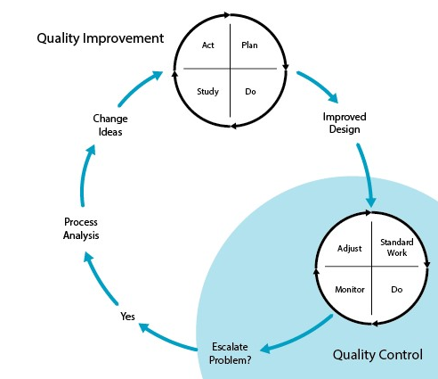
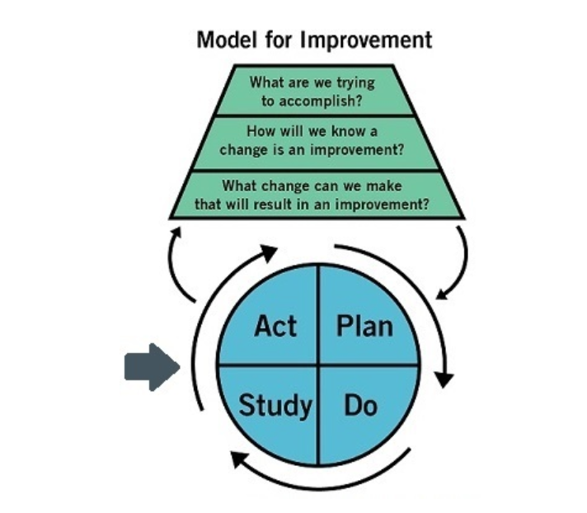
11 steps to Quality Improvement
1. Opportunity for Improvement
2. Form a team
3. Understand the system
4. Set aim
5. Change ideas
6. Plan measures
7. Create project plan
8. Test changes using PDSA
9. Implement changes
10. Sustain
11. Spread
11 steps to Quality Improvement
Notes:
Moving from the theory to the practice of QI, this cycle of steps will guide you through the process from having an idea, a need or requirement to implementing change in practice. This approach can be used irrespective of which QI methodology you use. I will describe later a scientific model ‘ The Model for Improvement’ used in healthcare for QI .
Why would you use an approach or method to implement changes?
The change you are trying to make may be difficult or challenging,
you may not know the real cause of the problem or the right solution,
or you may need to test out a number of solutions,
it may require the support of a wider team , not directly under your influence,
it may cross many departments or processes or
on the otherhand you know what needs to be implemented i.e. best practice or need to achieve a standard but you predict that introducing or embedding the change may be complicated or complex.
The benefits I have found in using a method or systematic approach is that it:
helps you plan change you are going to make,
Understand the problem in depth and the environment in which you are making the change within
get the right people involved who will support and commit to improvement
trial it in practice to see if it actually leads to improvement ,or identify issues with implementing an improved standard of care
measure the outcome of the change and if it leads to improvement
plan to implement and sustain the new way of working.
The reason I have stepped this out is because each one is important, I will describe each phase in detail but in summary Steps 1,2,3 preparing for the change, the ground work .
. 4,5,6,and 8 includes the stages in using a QI method, the MFI I have added step 7 which involves planning the implementation of changes in practice, 9 & 10 are the hard work- at this point you are planning to do something differently , you need all the relevant staff on board , this is the new way, this takes time and energy deserve to be emphasised.

Slide 27
FYI
Defining terminology frequently used to refer to QI Teams
Types of Teams
Uni-disciplinary ( made up of staff from the same background working together
Multi- disciplinary (members from more than one discipline working together),
Inter-disciplinary ( group of professionals from several disciplines working together in the same setting)

