Slide 2
What is Quality Care
Quality is care that is;
Safe,
Effective,
Efficient,
Timely,
Equitable,
Patient centred.
(IOM, 2006).

Slide 3
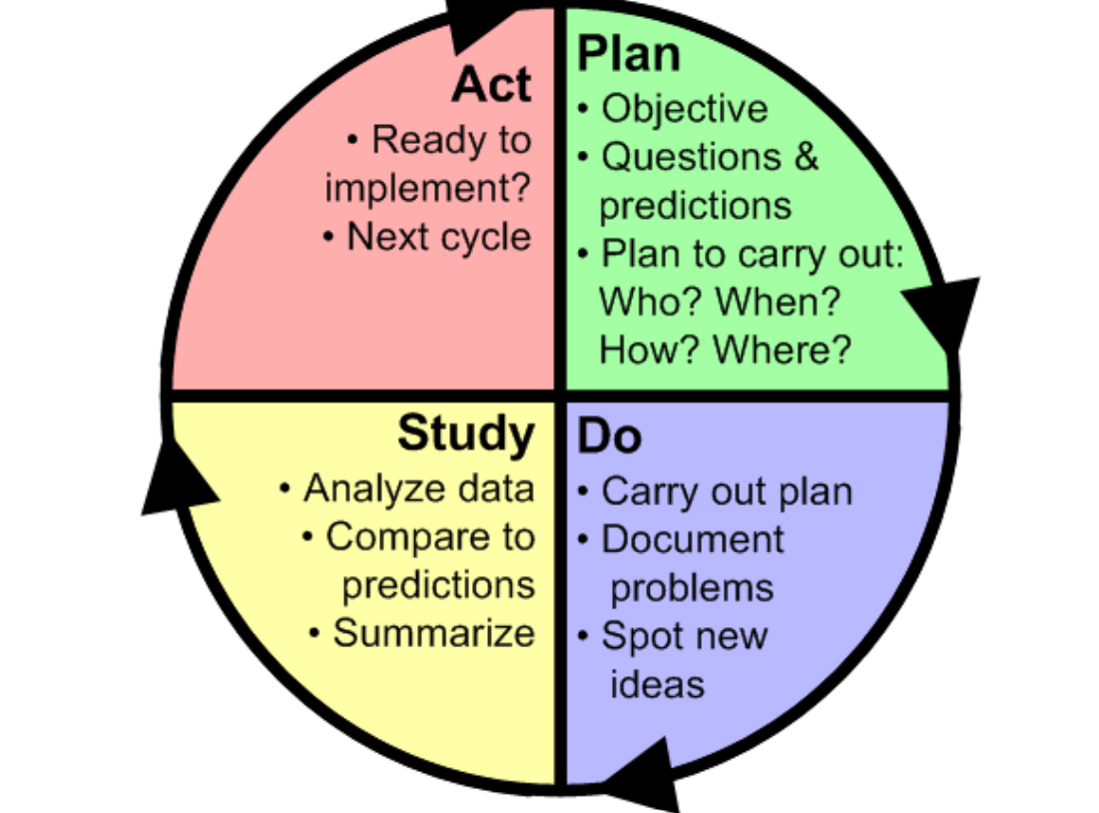
The Model For Improvement
PDSA’s are part of the framework for improvement
Aim
Measurement
Change ideas
Testing of change ideas in practice to determine if the change results in Improvement
The Improvement Guide Langley J et al 2009

Slide 4
Before you start your PDSA
The improvement team will have answered the 3 questions of the Model For Improvement
Question 1. What are you trying to accomplish- Aim
Question 2. What changes will you make that will result in improvement-Change ideas
Question 3 . How will you know the change has led to improvement-Measurement

Slide 5
The Model for Improvement introduces us to the principle of testing out changes while monitoring outcome and process measures to determine if the changes are leading to an improvement before being implemented in practice.
Testing also allows the necessary modifications to the original idea before it is made permanent. (Green et al. 2019, p.14)

Slide 6
PDSA’s take your change idea and tests it in practice to see if it leads to improvement before it is implemented in practice
Reed and Card (2016) state that PDSA’s focus on the:
Crux of change
helping to
translate ideas and intentions into action.

Slide 7
Why Test a change in practice prior to implementation
Build evidence about whether it is an improvement- it increases confidence and knowledge about the change
Run a small experiment to try out a new idea at the same time as doing what you normally do- Its less disruptive
You don’t have to convince lots of people that your idea is a good one- start working with the willing
Can get rid of teething problems before implementation
You can check that the change works under different conditions
Other people can learn from it and are more likely to try it
Can check if it works as well for us as it did for others

Slide 8
PDSA cycles consists of:
Iterative testing
Small tests of change
Carried out in rapid cycles
Real work settings
To learn which changes in which contexts produce improvement
Several PDSA’s are linked sequentially
Tested under a variety of conditions in real work settings
Rapid cycles allow for evaluation to determine if a change is an improvement
PDSA is not a one-time event
Each cycle builds on the current knowledge about the changes you are trying
Ramps of increasing scale

Slide 9
PDSA- Sequential building of knowledge
For one change idea,
we would expect to go through a series of PDSA cycles before we are ready for implementation.
This is called a ‘ramp’ of PDSA cycles.
Each change idea will have its own ramp.
Some may never reach implementation, if you learn that this change doesn’t lead to the improvement you are looking for.

Slide 10
Testing changes in Practice
This is where the PDSA cycle portion of the Model for Improvement comes in.
Planning a test of change, -Plan
Trying the plan, -Do
Observing the results, -Study
Acting on what you learn, -Act
Progressively move toward your aim.

Slide 11
Planning phase of a PDSA
Provost and Murray (2011) recommend the following actions as part of the planning stage:
Agree the objective of the PDSA cycle
Define specific questions to be answered in the cycle
These questions describe the teams predictions about the changes that will be tested
The predictions should be worded in such a way that the results of the tests conducted in the cycle can be compared to the predictions
The basics:
Who will schedule and conduct the test?
Exactly what changes will be made?
Where will the test be conducted?
When will the test be done?
What data will be collected to answer the questions in the cycle?

Slide 12
Measurement during PDSA cycles
Why- All improvement will require change, but not all change will result in improvement – One of the questions of the Model For Improvement- How will you know the change is an improvement?
What information is important to collect?
Why is it important?
Who will collect the data?
Who will analyze the data prior to “Study”?
Where will data be collected?
When will data collection take place?
How will the data (measures or observations) be collected?
Scottish Improvement Skills

Slide 13
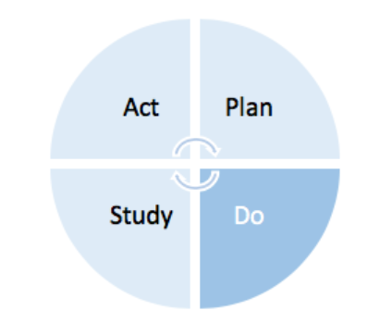
Do Phase of the PDSA cycle
The Do phase
Test is performed
Problems are documented
Observe for new ideas
Collect data

Slide 14
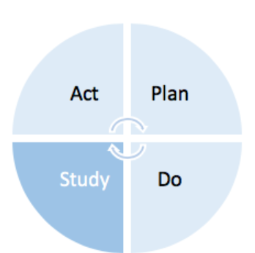
Study phase of the PDSA cycle
The Study Phase/Evaluation
Asking what happened when you ran the test
Were you able to run the test
Analyse data both quantitative and qualitative
Was there an improvement in the outcome measure when you ran the test
Compare the findings to your predictions
Was there any negative consequences with running the test
Summarise what you learnt

Slide 15
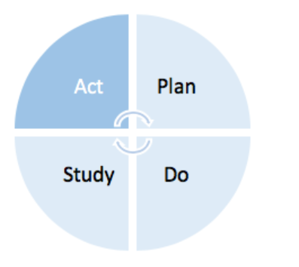
Act phase of the PDSA cycle
Taking action based on new knowledge in the act phase (Provost and Murray 2011, p.8).
Does the change need to be modified slightly to get it to work better, if so adapt and run the test again on a small scale
If the change worked well, increase the scale and test again
Then test under a range of different conditions to check if the change still leads to improvement
If the change showed no improvement at all, you may decide to abandon the it and test another change
3 A’s- Adapt, Adopt, Abandon.

Slide 16
Challenges to using PDSA
Reed and Card (2016) cited one of the main problems encountered in using PDSA is the:
“misperception that it is simple to apply and that it can be used as a standalone method”.
Successful PDSA process does not equal a successful quality improvement process or project. In complex systems, the process of change rarely progresses in simple linear ramps.

Slide 17
Some common mistakes when using PDSA cycles

